Slide 1
Search Engine Optimization: Putting the Library Where the Users Are
Wilhelmina Randtke
June 23, 2012
ALA Annual Meeting
Anaheim, California
Materials online at www.randtke.com/presentations/ALA2012.html
Notes:
Hello, I’m Wilhelmina Randtke. I’m currently Electronic Services Librarian at St. Mary’s University in San Antonio Texas.
Today, I’ll present on Webscraping on a Shoestring with No I.T. Support.
The focus of the this presentation is government documents, and simple web scraping tools, which someone could use without needing to have much technological skill. If you are a government documents enthusiast, or are in a library which has no I.T. support, then I hope to give you some simple tools you can take home to do webscraping projects.

Slide 2
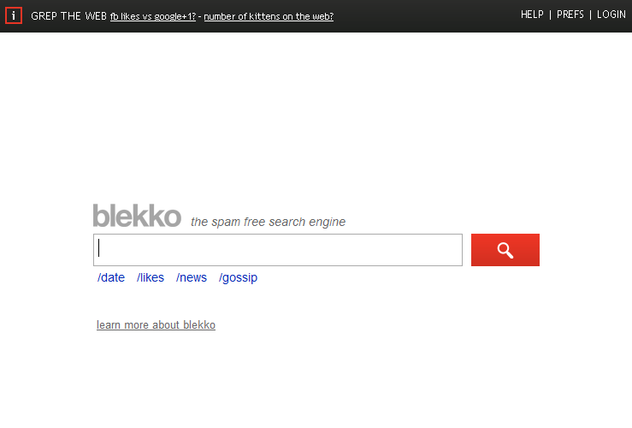
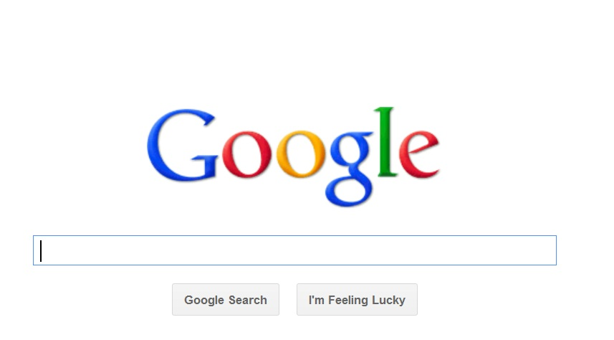
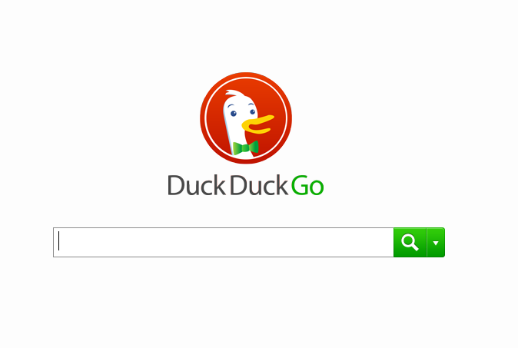
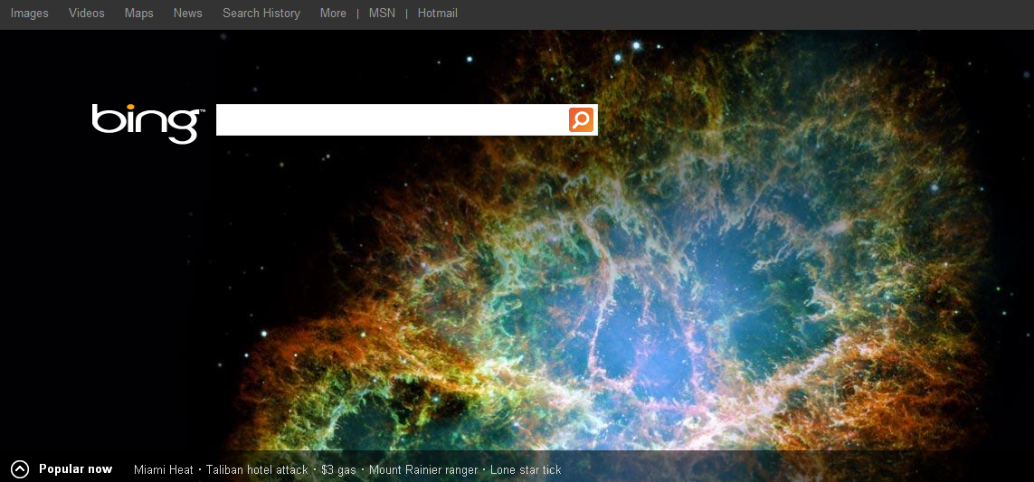
Search engines
Notes:
I’m Wilhelmina Randtke. I’m an Electronic Services Librarian at St. Mary’s University in San Antonio Texas.
Today I’m talking about search engine optimization.

Slide 3
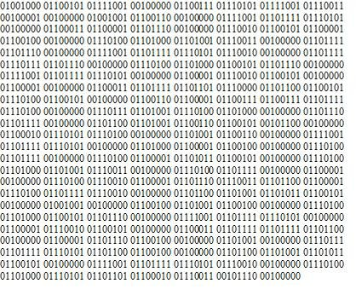
1s and 0s pic
Notes:
This is the transition which everyone’s been dealing with for the recent decades. Material going digital.

Slide 4
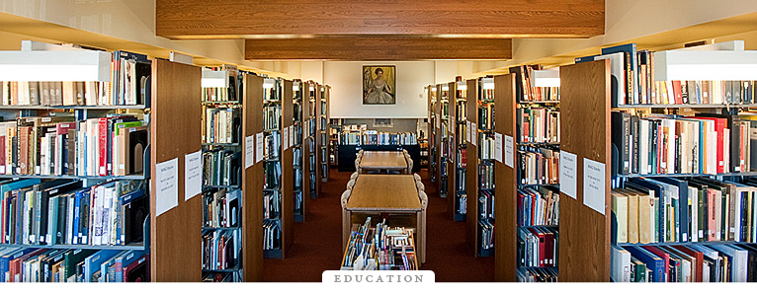
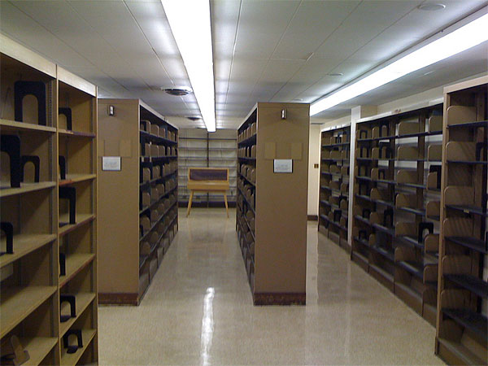
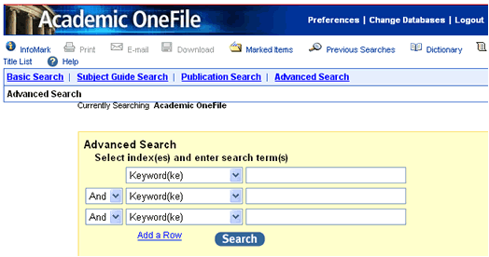
How have we responded?
Some empty shelves on one side; some databases on the other, some empty shelves
Notes:
So, the shift of the last decades led to the information leaving the physical space, and moving to the digital space.
The results of this shift: We have an empty building, and a full internet.
How have we responded?
Let’s compare our professional focus on the void left by paper with our professional focus on the new starting place for research.

Slide 5
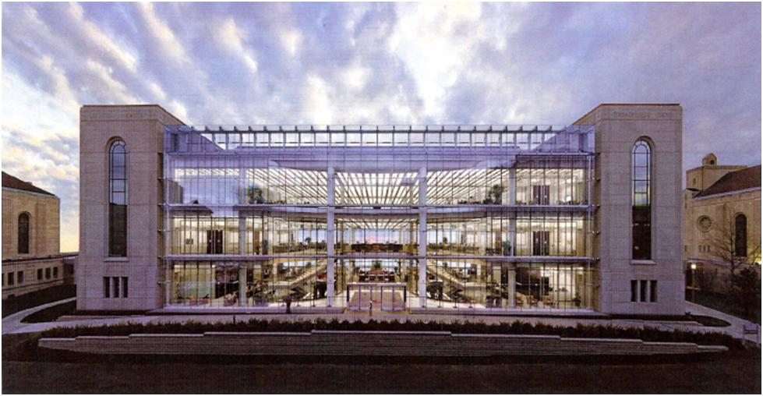
Information commons
Notes:
As a profession, we focus on the void.
The buzz about learning commons, information commons, goes all through the profession. You get shots of library redesign, and architectural wonders.
We spend money on the databases, but in terms of structuring an experience for patrons – this is where the money goes.

Slide 6
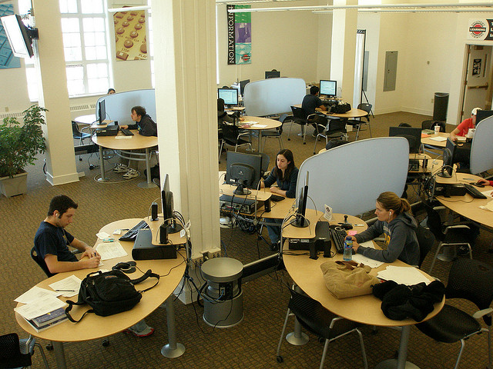
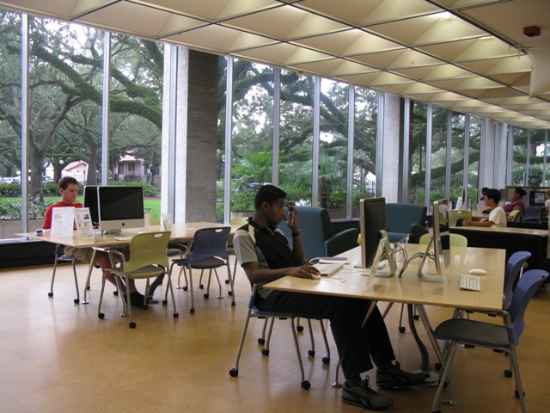
Computers in a learning commons.
Notes:
Two things are going on here:
One, the computers are in the library, and people come in to use them.
Two, the people use the computer to follow the information and go online. They use the computer to leave the library.
So, the bulk of resources here go to buy the computers, provide staff to fix the computers, but not to building the place people go.

Slide 7
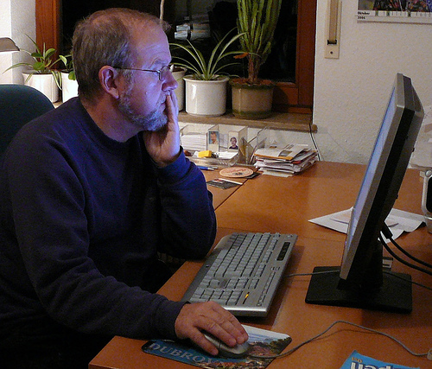
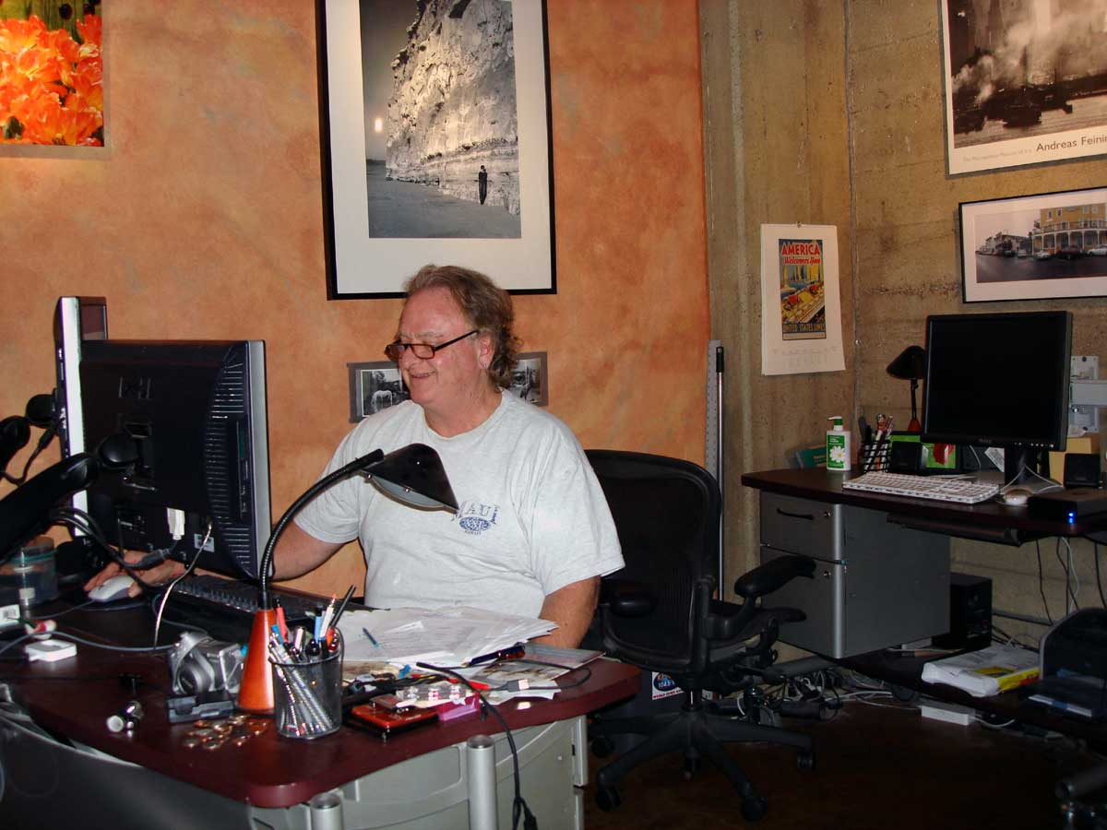
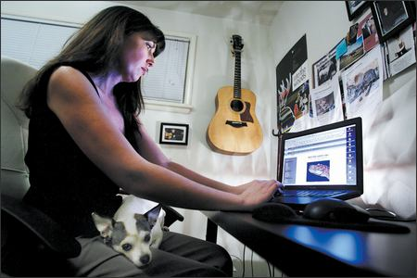
Person studying
Notes:
And we don’t even reach this person.

Slide 8
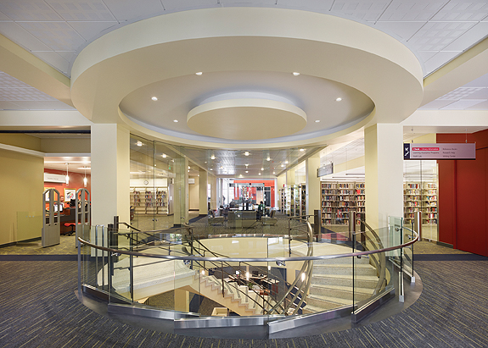
Information commons that looks especially empty
Notes:
Today, I am not going to talk about how to do search engine optimization. Instead, I want to argue that it should be a focal point for our profession.
I want to shift the focus away from this void, and toward where the information went.
And, I want to focus on a role which we are loosing as a profession, and that is as an architect. Structuring the research process, not by teaching, not by doing short instructional sessions, but instead by making the world people find.
This isn’t practical. It’s an attempt to shift the mindset.

Slide 9
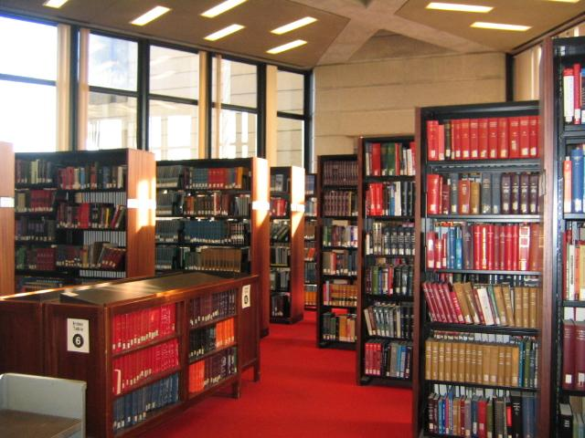
Research ecosystem of the past…
Old library pic
Notes:
This is what I mean. It’s the research environment of 30 years ago. The reference shelf is in the front. The most important books are there. And, no one has to tell me, those are most important for me to know. They are front and center.
When I find a book about what I want, I can look next to it, and I find a similar book. Every time I look at a shelf, it’s like that – the similar things are together.

Slide 10
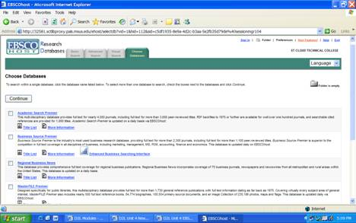
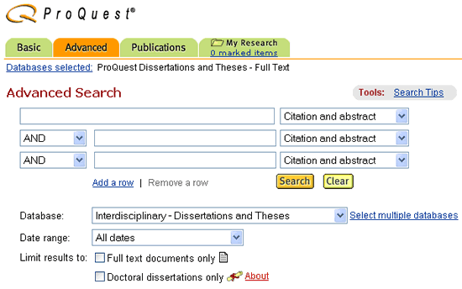
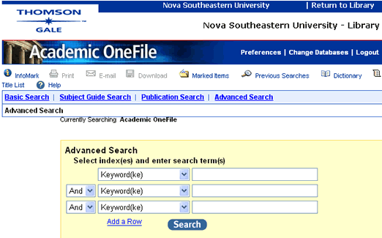
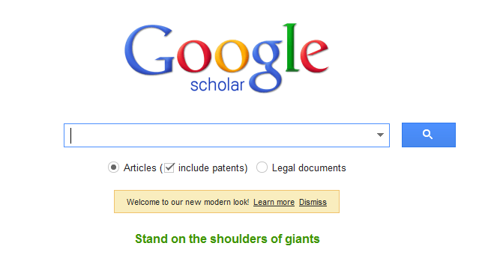
Research ecosystem of the present…
Some databases
Is this really where people start?
Notes:
This is the research world we like to be experts in. We do instructional sessions on these. We try to put adds on our website, to move them up front – like the reference shelf.
This is the modern research world - lots of databases. Or is it?
Where do people really start?

Slide 11
google
Notes:
They start at the search engine

Slide 12
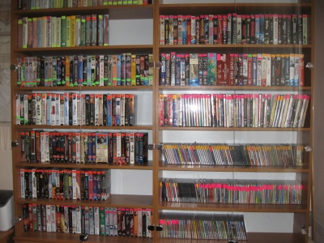
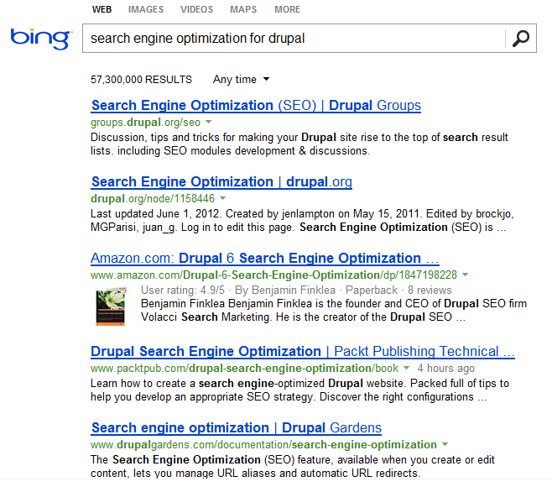
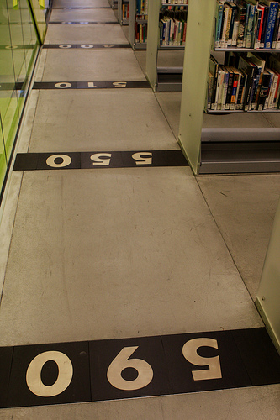
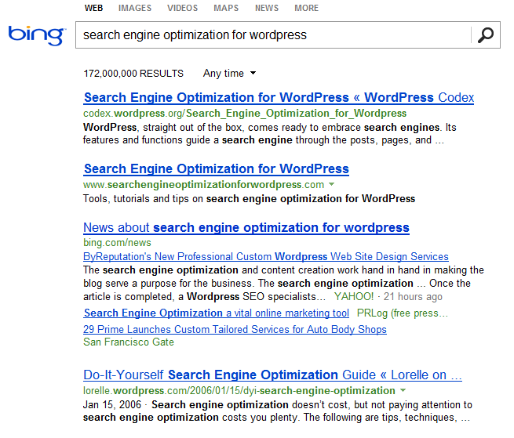
Notes:
Similar to adjacent books, grouped intentionally by call number, we have adjacent search results. The grouping and ranking is very intentional. And librarians have nothing to do with their placement.
But does it have to be this way?
Business certainly tries to understand and game this system. There is a lot of guidance for businesses on how to game search results.
Meanwhile, in library land, the only place I’ve seen this focus is when we implement discovery tools. Then we suddenly care. But maybe that’s because we just spent a lot of money on a discovery tool, and we just spent a lot of money on those databases.

Slide 13
Can you spot authors? Publishers? Librarians?
Old library pic
Notes:
Let’s go back to the old world:
Can you spot the Author? Publisher? Librarian?

Slide 14
Can you spot the authors? Publishers? Librarians?
Some databases
Notes:
And in the modern research world:
Can you spot the Author? Publisher? Librarian?

Slide 15
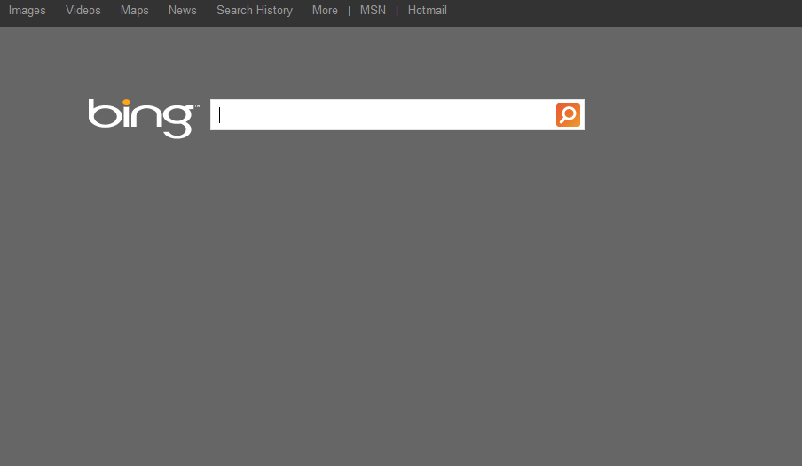
Can you spot the authors? Publishers? Librarians?
Notes:
And in maybe the modern research world:
Can you spot the Author? Publisher? Librarian?

Slide 16
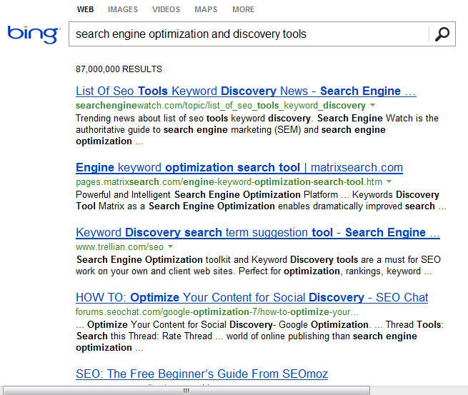
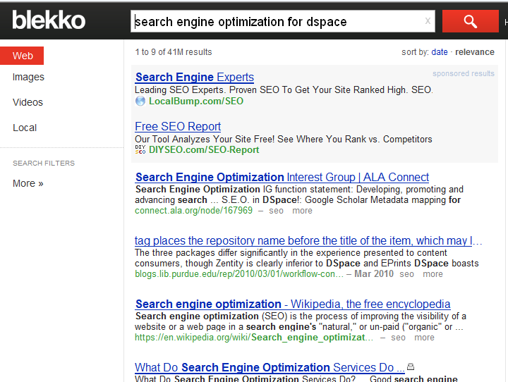
Internal focus: Optimize your content
Notes:
There are two angles to go at with search engine optimization. There first is to look at each tool the library uses, and find ways optimize it.
This will move library webpages up in search results.
But, historically, the research environment lived in the library because it was made of paper. It had to live somewhere.
Historically, the library content was only in support of the research environment. The library isn’t a printing press; it’s a conduit.

Slide 17
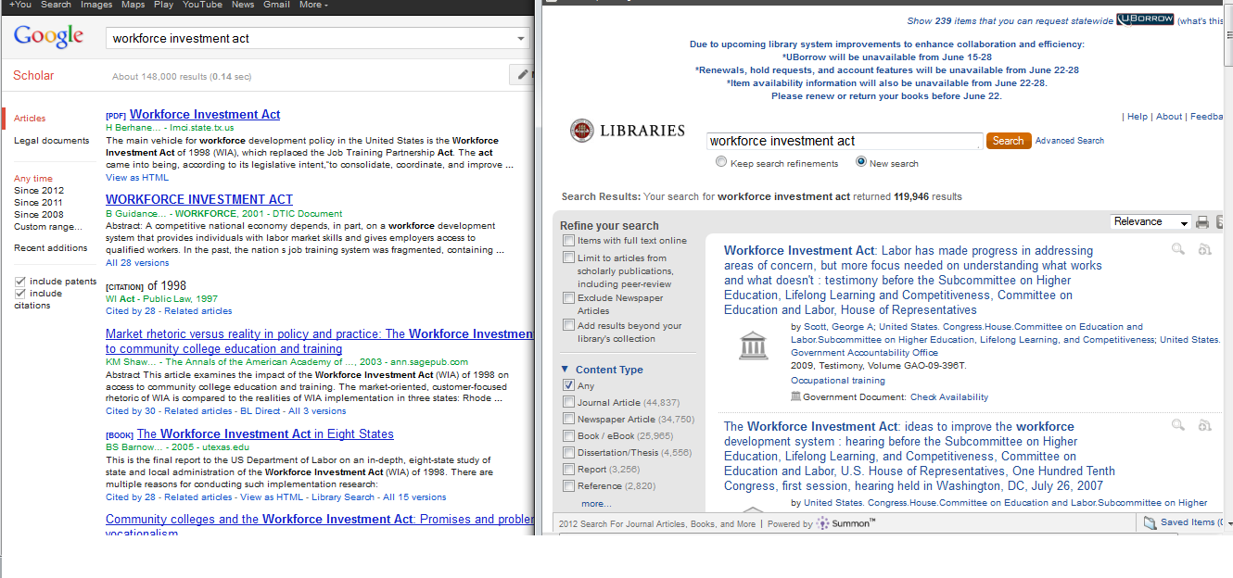
Internal focus: Optimize your tools
Notes:
Where are we a conduit? Discovery tools is an area where libraries are getting involved in trying to structure the search quality. Not like comparing database results, teaching Boolean, whatever. Here we try to move relevant things to the top.
This is the discovery tool for FSU Libraries, and this is Google Scholar.
If Google Scholar is more relevant, maybe that’s something to fix.

Slide 18
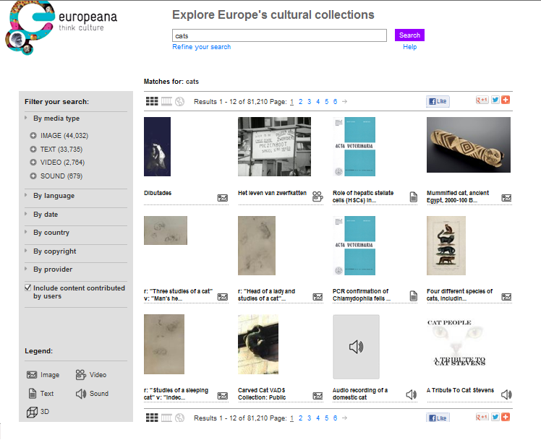
External focus: Optimize shared tools
Notes:
The library community also has some search systems. This is Europeana, which searches across digital collections of libraries in Europe. Good results here are key to people using this, instead of using Bing, Google, whatever else.
It’s a search built and controlled by the library community.

Slide 19
Use Awareness to Change Outside
Notes:
The librarian has never been a publisher, or source of information. Instead, the librarian is a conduit. Taking some information and passing it to where people are.
So, a bigger way to retake the role of architect is to focus on how to act as a conduit in this environment, where the mechanics of search are outside the library’s direct control.
Does the search engine look at location, and change search results based on that? Why is one result better than the other?
This will help teach research skills.

Slide 20
Notes:
But, when it comes to being an architect and building the information environment, you have to look and say: What do we have that people want? Librarians are not motivated to sell. People know that money plays into search results. Search placement is advertising.
There is a desire to be able to get away from that, and that’s an entry point for librarians into general search systems.

Slide 21
Quick tips and things to do:
For tools used by the library, do a little optimization.
Look up and read an article about search engine optimization for each web platform used by your library.
Focus on search quality in library tools.
Discovery tools
Searches for library-published digital collections
Learn how search engines work, and advocate for high quality neutral results.

Slide 22
Search Engine Optimization: Putting the Library Where the Users Are
Wilhelmina Randtke
June 23, 2012
ALA Annual Meeting
Anaheim, California
Materials online at www.randtke.com/presentations/ALA2012.html
Notes:
Hello, I’m Wilhelmina Randtke. I’m currently Electronic Services Librarian at St. Mary’s University in San Antonio Texas.
Today, I’ll present on Webscraping on a Shoestring with No I.T. Support.
The focus of the this presentation is government documents, and simple web scraping tools, which someone could use without needing to have much technological skill. If you are a government documents enthusiast, or are in a library which has no I.T. support, then I hope to give you some simple tools you can take home to do webscraping projects.

