Slide 1
Open Source Software Tools for Law Libraries
Fang Wang & Wilhelmina Randtke
St. Mary’s University Law Library, April 4, 2013

Slide 2
What Is Open Source Software?
Open source is a collaborative software development method that harnesses the power of peer review and transparency of process to develop code that is freely accessible.
Open source software is software that users have the ability to use, distribute, study and modify for any purpose.
Proprietary software
Free software

Slide 3
The Reality
Economic crisis, budget cuts.
The field of law is changing. Technology helps to prepare lawyers.
The cost of technology tools is high.
Law librarians are asked to do more with less.
Adapt, incorporate, change.

Slide 4
Why Open Source?
Free or low cost
No vendor lock-in
User centric development
Freedom to innovate
Reliable through peer review

Slide 5
Myths about Open Source
“Open source is more risky because the project/software/community could just disappear!”
“Open source must be less secure. Anyone could just add malicious code!”
“If we go with open source, we won’t be able to get support!”

Slide 6
Gartner Survey on Open Source Software

Slide 7
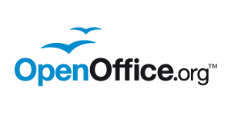
Tools You Probably Know of
Firefox
OpenOffice
VLC

Slide 8
Tools You Might Not Know
Content Management: Drupal, WordPress, Omeka
Integrated Library System: Evergreen, Koha
Course Management: Moodle
Survey: Limesurvey
Repository: DSpace, Eprints, Fedora
Journal publishing: Open Journal Systems
Image Editing: GIMP
Operating System: Ubuntu
……

Slide 9
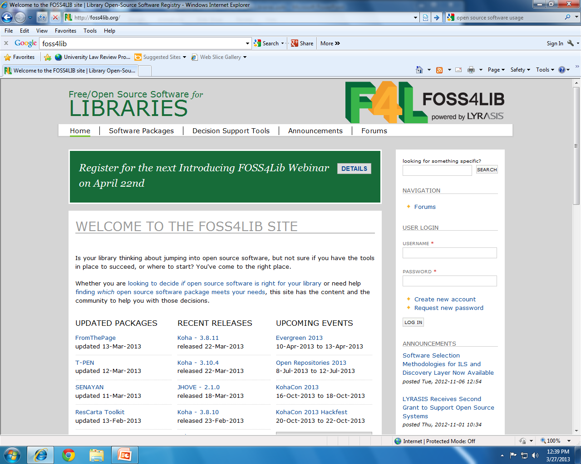

Slide 10
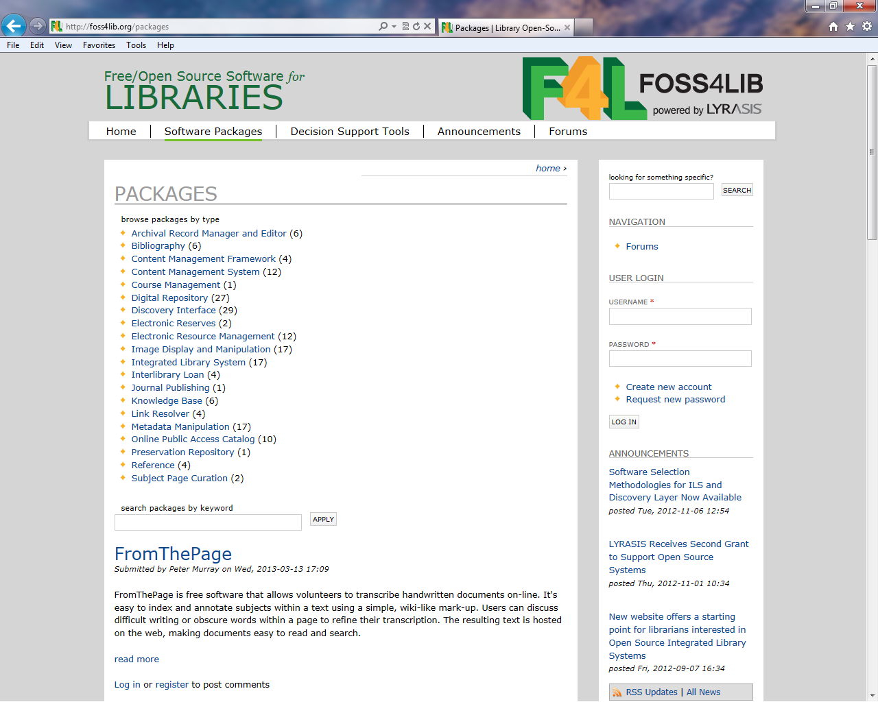

Slide 11
Is Open Source Right for Me and My Law Library?
Self-guided Readiness Assessment Survey:
http://foss4lib.org/decision-support/control-versus-responsibility/online-interactive-version-survey

Slide 12
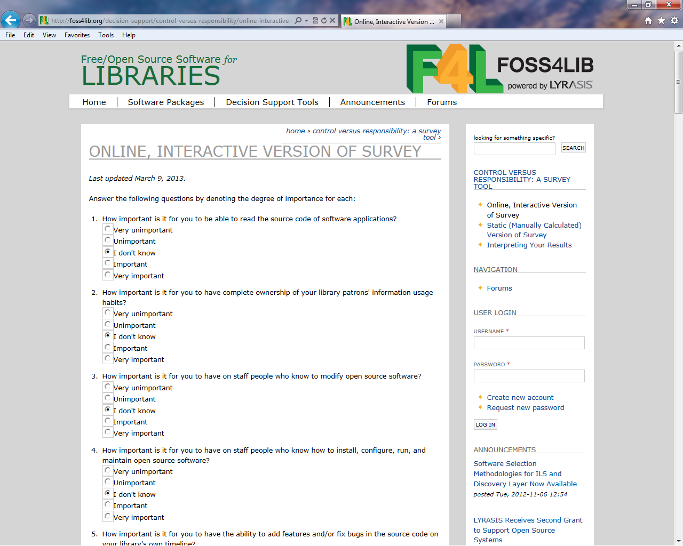
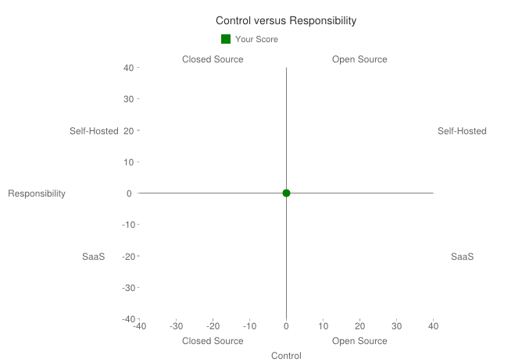

Slide 13
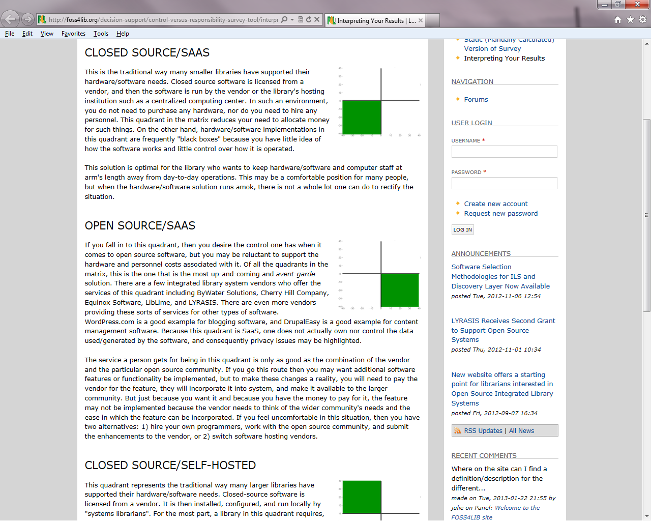

Slide 14
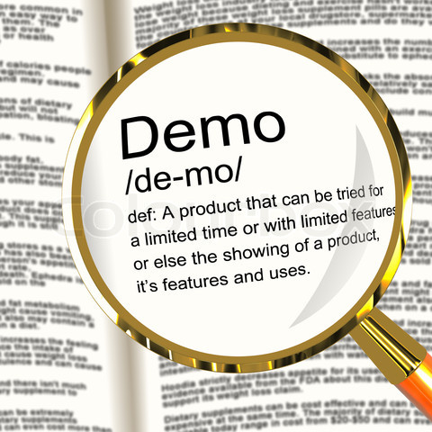
Demos on Open Source Projects

Slide 15
Open Source Projects at St. Mary’s law
Open source for web development
Open source applications
Notes:
Web development is one of the most focused on areas for open source. Remember, the FOSSforLib website, listed almost all software that will run on a server. These are two projects we accomplished in open source software for servers: an intranet and an institutional repository.

Slide 16
Open source Desktop Applications at St. Mary’s
Maps project: Making a map of the law library.
Sound transfer: Going from tape to mp3 (for ILL requests)

Slide 17
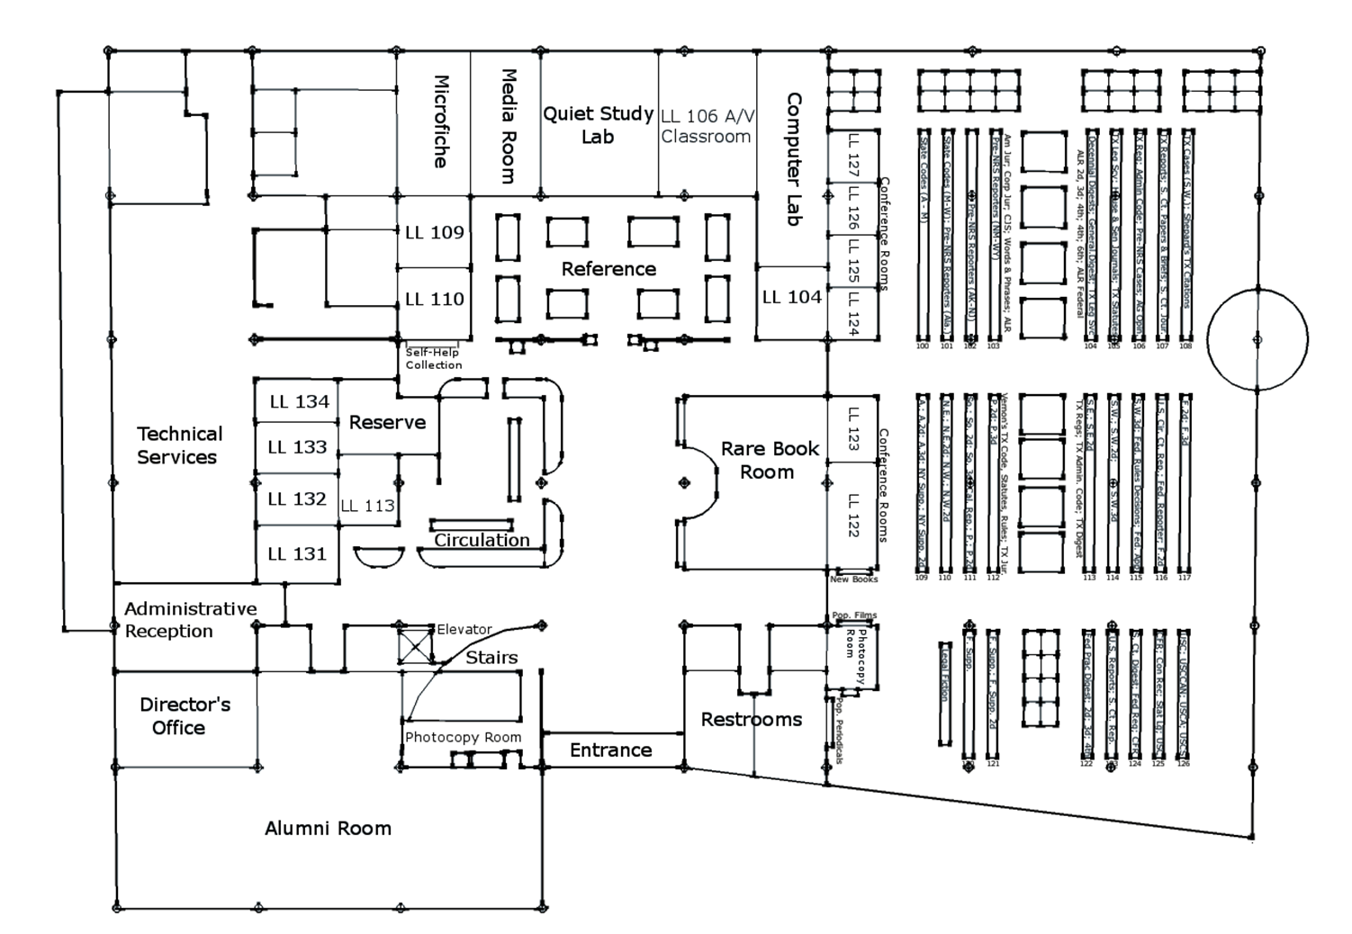
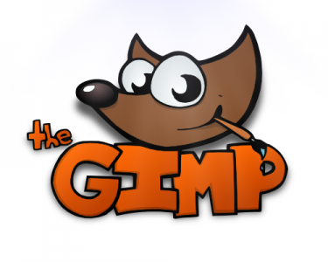
Maps Project: Image editing with GIMP
Notes:
Advantages:
This was our only graphics project. On our purchasing plan.

Slide 18
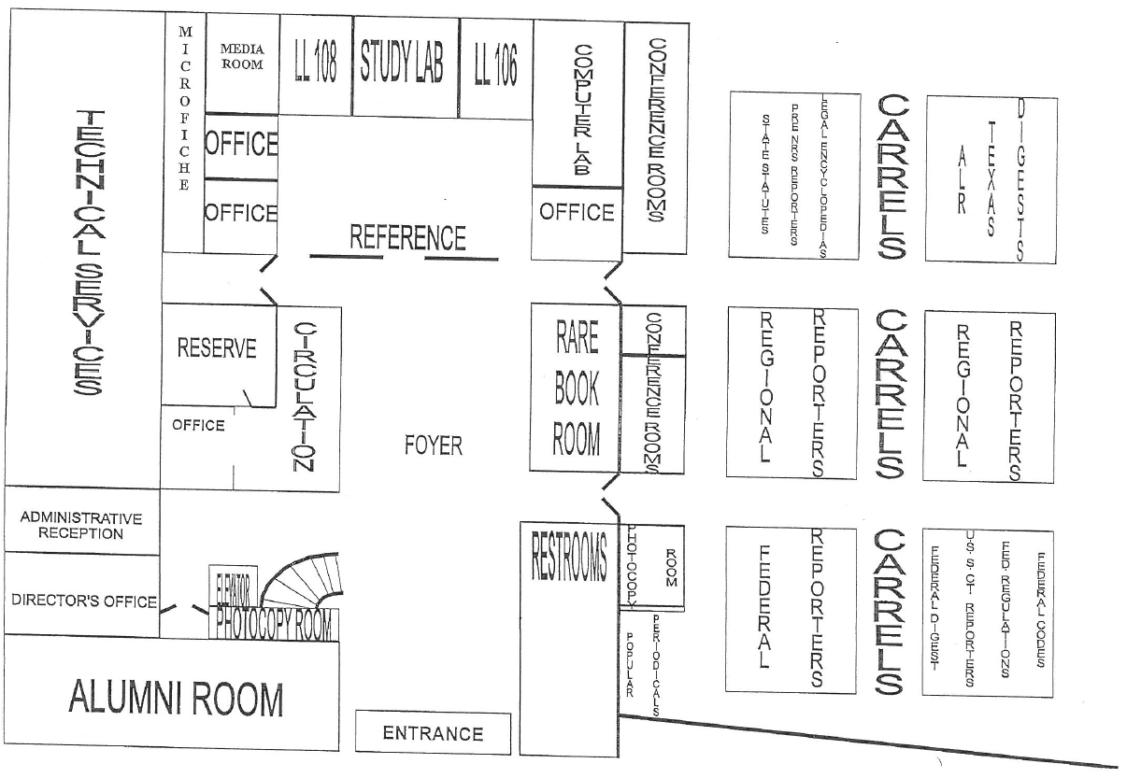
Old Map:

Slide 19
New Map:
Notes:
Advantages:
This was our only graphics project. On our purchasing plan.

Slide 20
Old
New

Slide 21
Project Planning:
Resources
Microsoft Paint
Project framework
Multiple librarians (so, need to share files)
A one hit project. Librarians rarely make a custom graphic. (We usually make posters with photographs.)
What software would you use?
Notes:
We needed a new map.
We had Microsoft Paint. It just does not cut it.
So, if you need graphics software, where do you go?
Photoshop, right?
We also identified

Slide 22
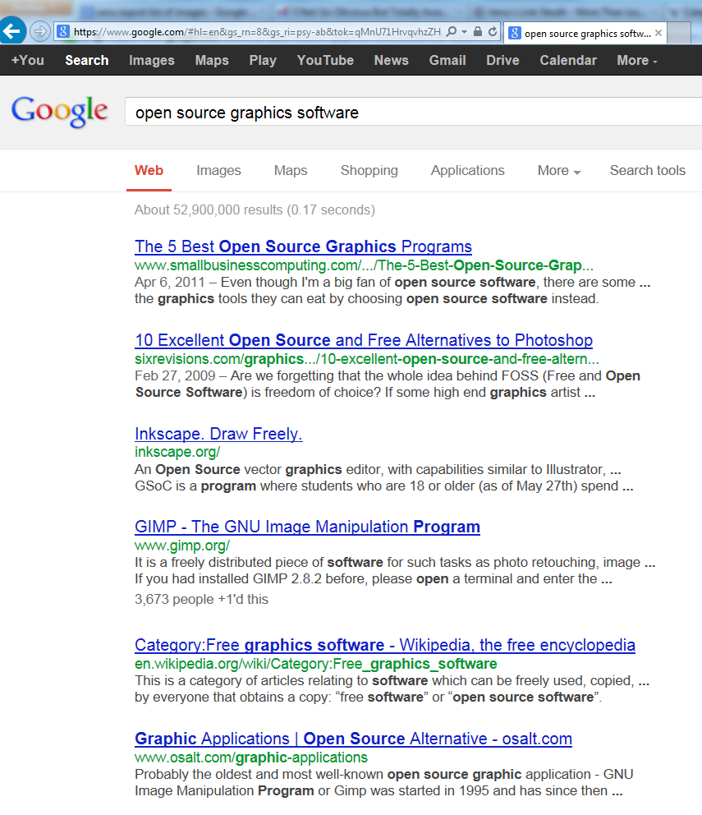
Multiple licenses was key.
Lets multiple librarians work on the project.
Notes:
A quick Google search revealed two programs on the first page. And, if you click the links for 5 best open source graphics programs and for 10 excellent alternatives to Photoshop, GIMP is on both lists.
The lists gave quick overviews of products. It took the same amount of time as researching “what is Photoshop?” “Can I do it in Publisher?” Same time to research as for proprietary software. Actually, faster to research than it was to collect information about the university’s set-up for purchasing Photoshop.
From a little bit of research, GIMP quickly came out as the go-to option and something that was as versatile as Photoshop.

Slide 23
Photoshop vs. GIMP
Photoshop
$160 per license at St. Mary’s, plus staff time to track and file license information centrally.
Everyone on the project needs a license to be able to edit files.
A learning curve.
GIMP
$0 per license; no need to manage licenses centrally.
Can immediately install on any librarian’s computer.
A learning curve. (similar to Photoshop)

Slide 24
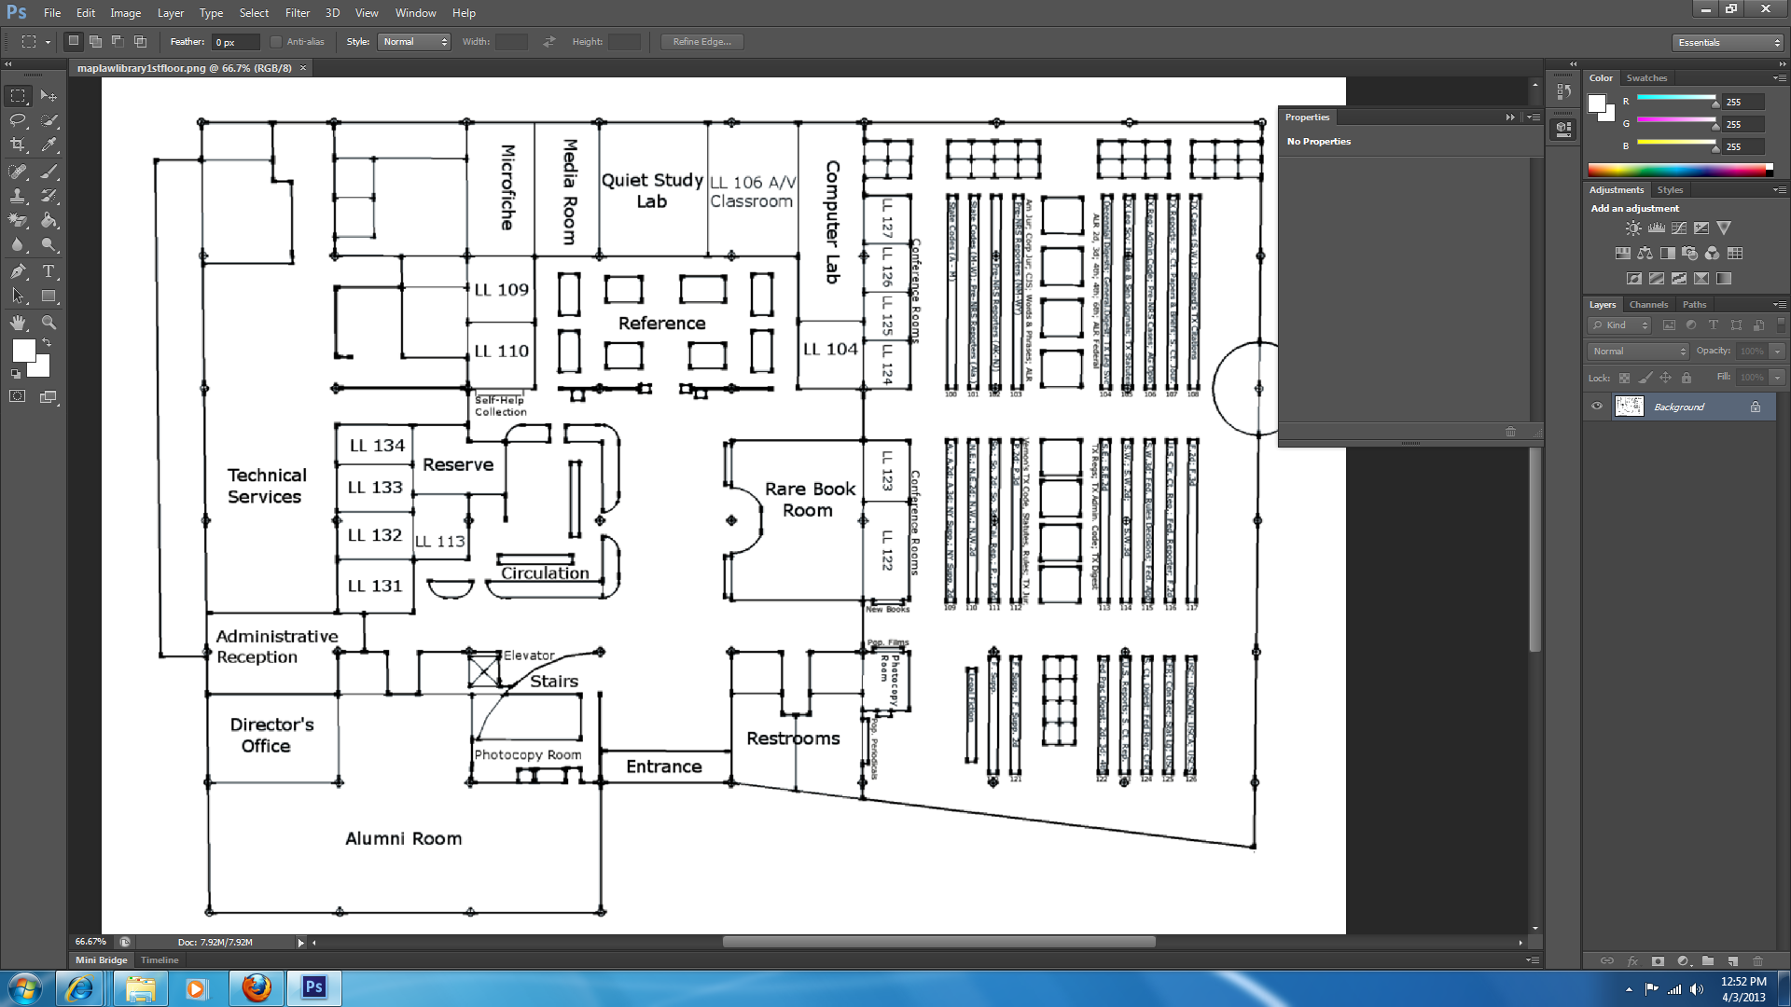
Photoshop Interface:
Notes:
This is to show the interfaces. The interfaces for Photoshop and GIMP are pretty similar.
This is the Photoshop interface.

Slide 25
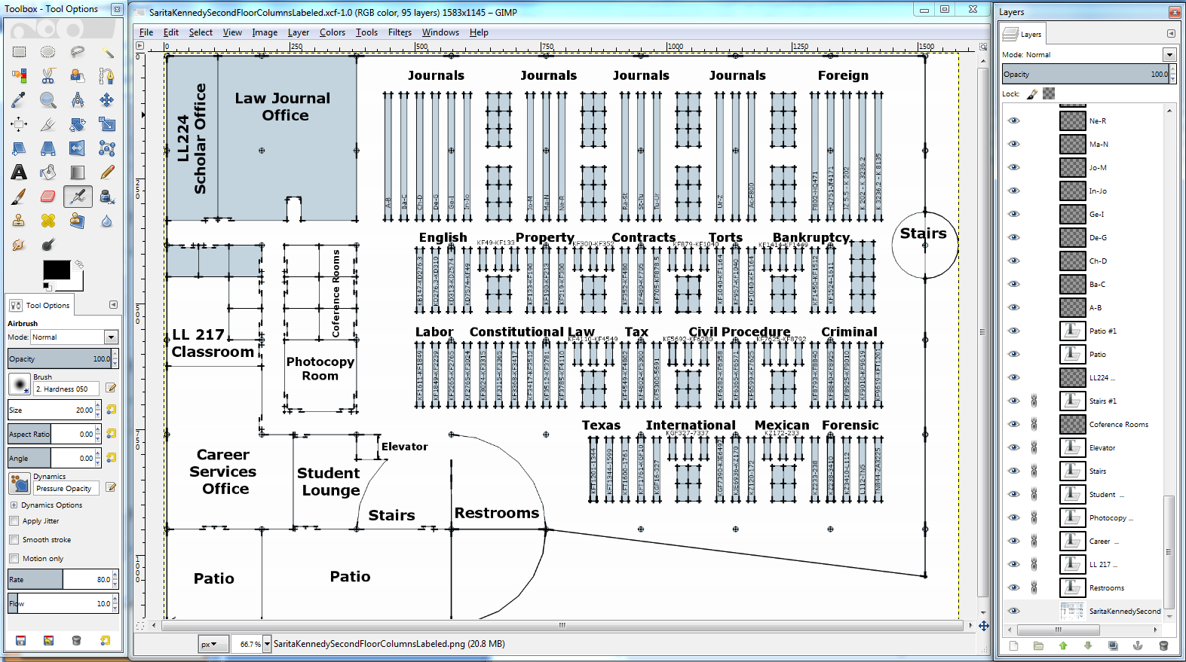
Gimp Interface:
Notes:
This is the GIMP interface.
One of the mental barriers to open source is that people may think it’s harder to learn.

Slide 26
Photoshop Interface:
Stuff I have to learn
Notes:
But when you have new software, you have to learn things even if you have an expensive system.
With Photoshop, you still need to learn it.

Slide 27
Gimp Interface:
Stuff I have to learn
Notes:
With GIMP, you still need to learn it.
But unless you are a graphic designer who already knows one or the other, it’s actually about the same amount of time to learn the open source. Same learning time; same software features. For this project, the open source software was completely suitable.

Slide 28
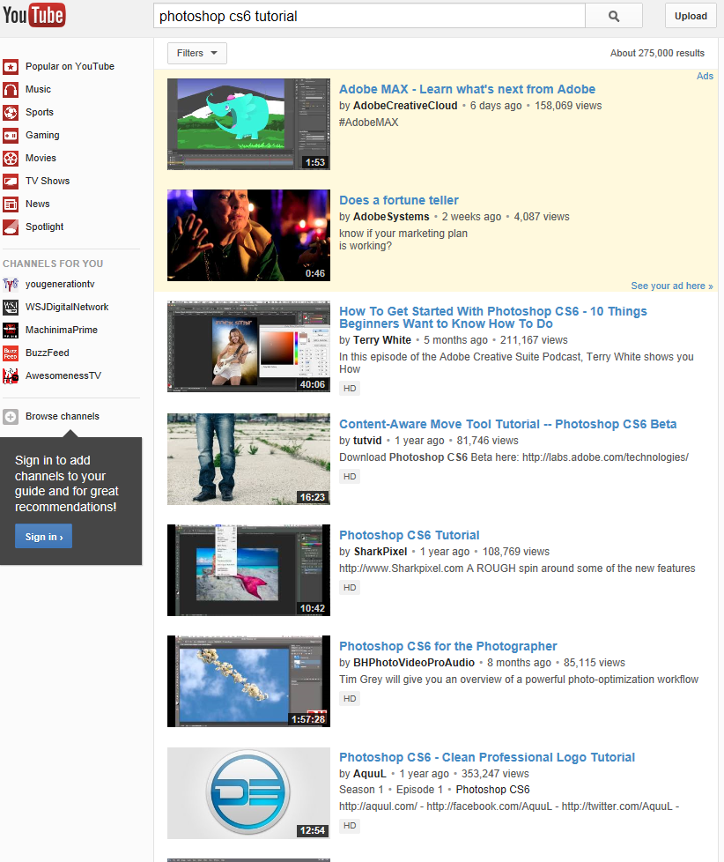
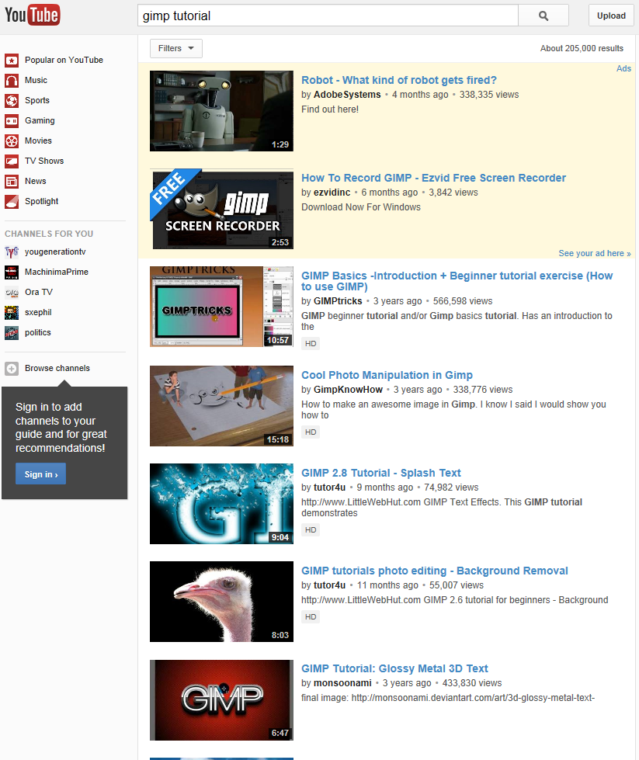
Training and Support Photoshop tutorials GIMP tutorials
Notes:
Open source software often has many more users than you would think. When I went to look for tutorials and instructions, I found them pretty easily.
Here you can see, I looked on YouTube for a quick intro tutorial, and I found these for both Photoshop and GIMP. So, it was as easy for me to go online and find instructions for GIMP as it was for Photoshop.

Slide 29
Maps Project: Image editing with GIMP
Notes:
We made a good quality image quickly using open source software. And we were able to store and archive our source files.

Slide 30
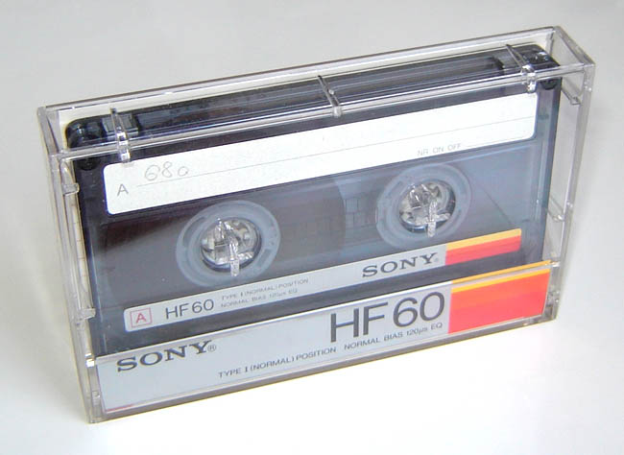
Audio Tape Conversion: Audacity for ILL
Notes:
In Texas, legislative histories matter more than most other states. We had a professor who did an interlibrary loan request for hearings on a bill. The Texas legislature is apparently retro, and mailed us audio tape copies. There is no way we can give a professor an audio tape. We recarpeted last year, and had even thrown away our tape player, because we don’t have anymore audio tapes. Tape players aren’t easy to find nowadays.
To convert the tape to mp3, we got a cable to connect a library tape player
Cassette image was released into the public domain by Orion 8. Image collected from http://commons.wikimedia.org/wiki/File:Compact_audio_cassette_1.jpg .

Slide 31
Texas Legislative materials
Recordings of floor debates and committee hearings
When you ILL material from the Texas Legislature, they will FedEx you an audio tape.
…. an audiotape…

Slide 32
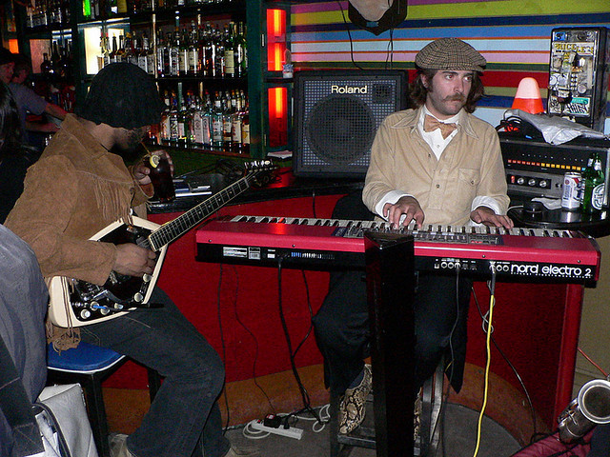
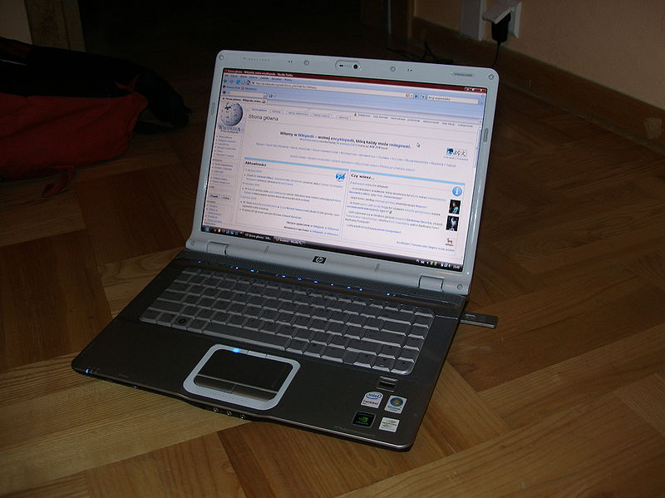
Hipsters Professors
Notes:
Photo of hipsters licensed under http://creativecommons.org/licenses/by/2.0/deed.en Photo by slava. Downloaded from http://www.flickr.com/photos/slava/285199203/sizes/z/in/photostream/ .
Photo of professors is from the St. Mary’s University School of Law archives.
Photo of laptop from http://commons.wikimedia.org/wiki/File:Laptop_HP.JPG by Shleiderbmx . Licensed under http://creativecommons.org/licenses/by/3.0/deed.en .

Slide 33
Project Planning:
Resources
We borrowed a tape player from the main campus library.
Project framework
It is unreasonable to give an audio tape to a professor.
Need to go from audiotape to mp3.
Need to do this quickly (in days, not in weeks).
What software would you use?
Notes:
In this case, “What software would you use?” is probably an open question.

Slide 34
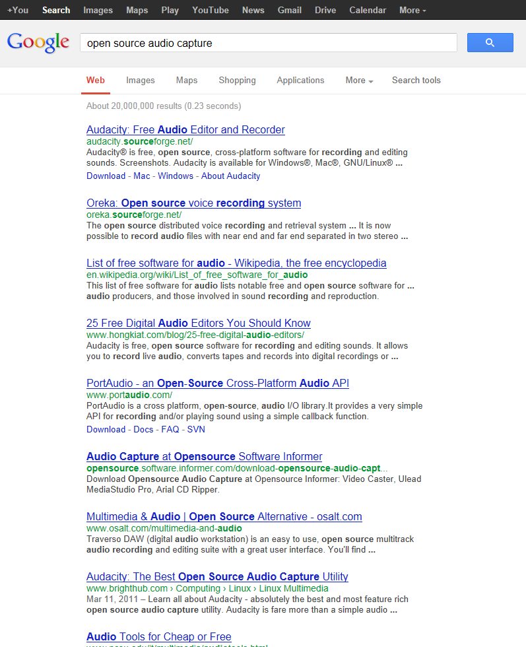
For audio editing, there is a very clear open source product.

Slide 35
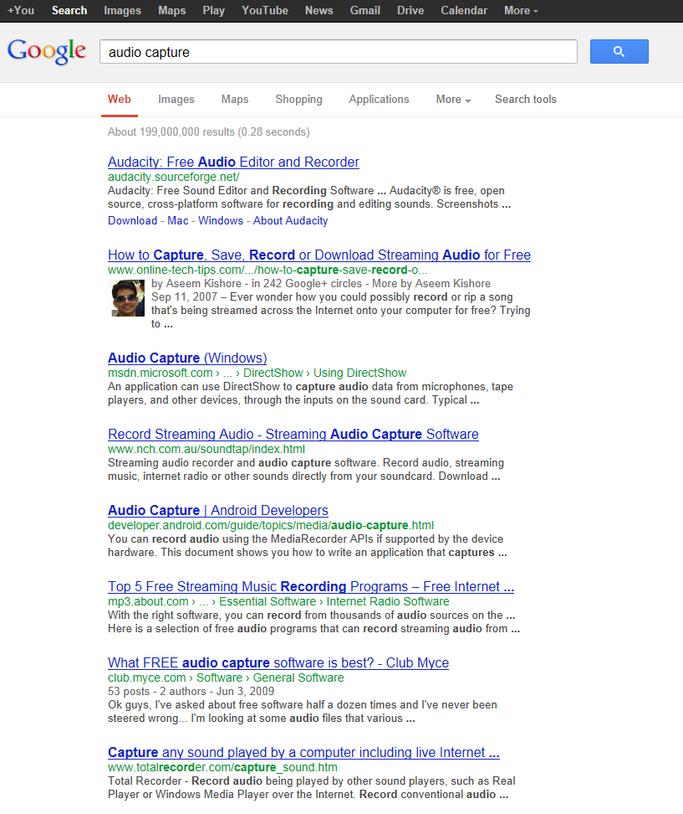
The open source software is also the dominant product. Period.
There also is no clear “go to” proprietary product.
Sound Forge Pro at $325 a license is a solid pick.

Slide 36
Audacity vs. Sound Forge Pro
Audacity
Can install it immediately; no purchase approval.
$0 per license; no need to manage licenses centrally.
Able to find instructions for what we needed to do (go from audiotape to mp3).
Sound Forge Pro
$325 per license; staff time to track the license for each install.
Able to find instructions for what we needed to do. But, fewer instructions available.

Slide 37
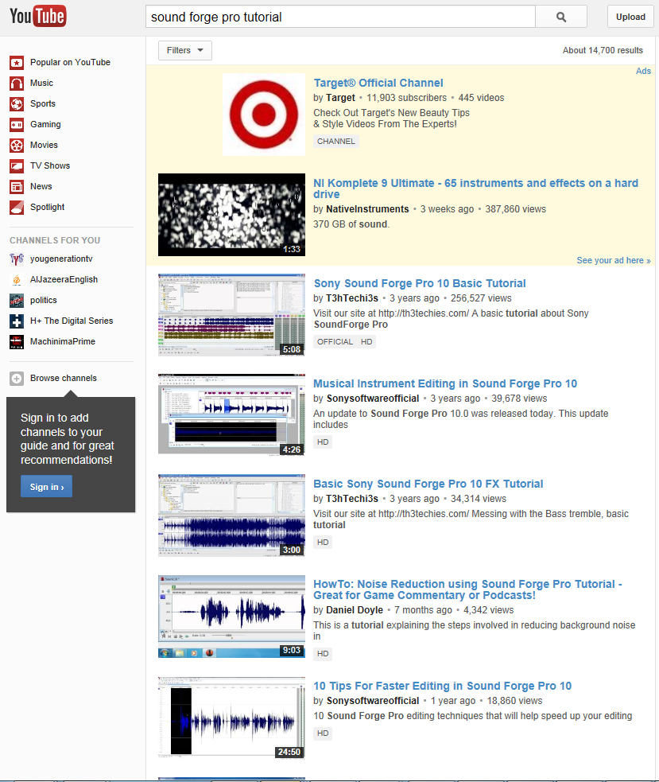
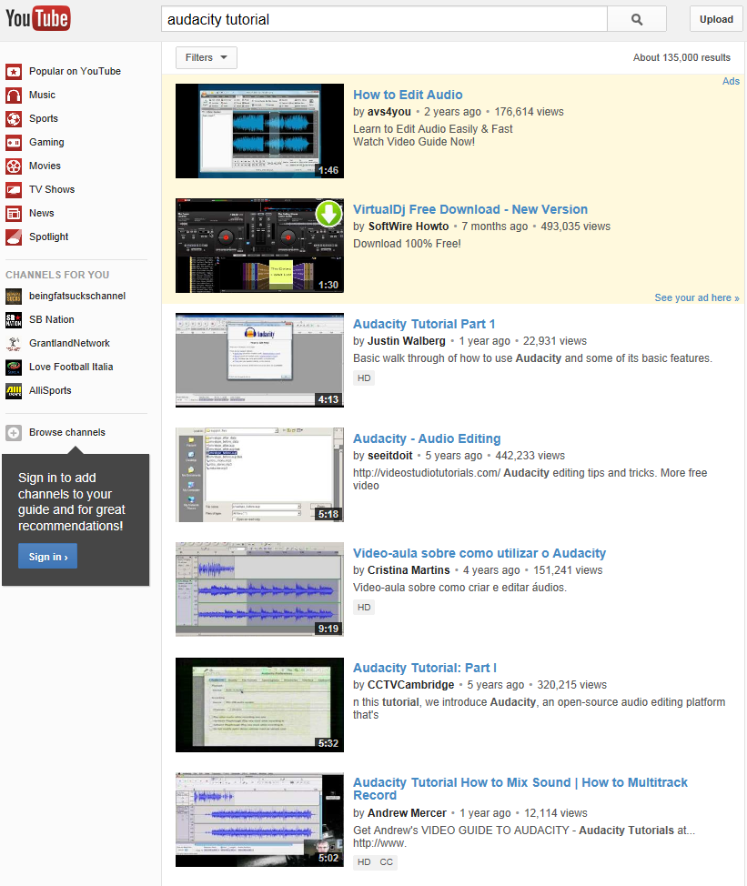
Training and Support Sound Forge Audacity
Notes:
In this case, vastly more support for the open source product.

Slide 38
Audio Tape Conversion: Audacity for ILL
Notes:
In Texas, legislative histories matter more than most other states. We had a professor who did an interlibrary loan request for hearings on a bill. The Texas legislature is apparently retro, and mailed us audio tape copies. There is no way we can give a professor an audio tape. We recarpeted last year, and had even thrown away our tape player, because we don’t have anymore audio tapes. Tape players aren’t easy to find nowadays.
To convert the tape to mp3, we got a cable to connect a library tape player
Cassette image was released into the public domain by Orion 8. Image collected from http://commons.wikimedia.org/wiki/File:Compact_audio_cassette_1.jpg .

Slide 39
Open source Web Development at St. Mary’s
Intranet
Institutional Repository
(both, and more, can run on the same server)

Slide 40
Open source Platforms vs Applications
Desktop Applications
Same amount of time to learn how to use open source software.
More documentation required for proprietary: Must track licenses for each install.
Platforms
Vendor run products are often very expensive. $1,000s per year.
More technical skill is required to do your own. (Still some technical skill to configure a vendor’s product.)
More documentation required for open source: Must keep configuration notes.

Slide 41
Open source Platforms vs Applications
Fewer hidden costs in proprietary platforms - CMSes, repository platforms, server stuff – (issues with server administration or troubleshooting).
Main benefit of open source is you can get a service plan or consultant, and there is competition there. No vendor lock in with open source.
Fewer hidden costs in open source desktop applications (issues with tracking licenses or finding install CDs 2 years later).

Slide 42
Background on St. Mary’s University
Small main campus
School of Law = about 900 students and faculty
Entire university (including the School of Law) = about 4,000 students and faculty
Limited IT support
Limited central resources (main campus is tiny)
Private: Funded by student tuition
Notes:
First, here is some background on St. Mary’s University School of Law. The most distinctive thing about electronic resources at St. Mary’s is that the main campus is tiny.

Slide 43
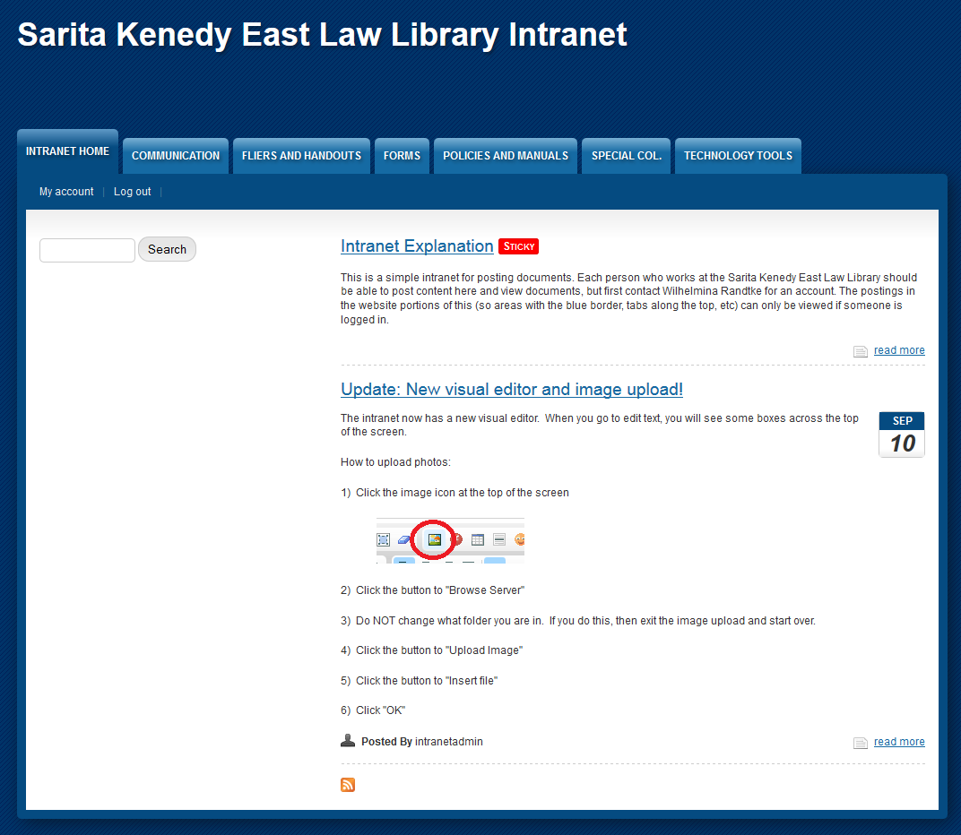
Intranet: Quick file sharing in Drupal
Simple place to keep documents and policies
Goal = nothing lives in email
Drupal one click install
non technical
Security issues:
Can’t be used for truly confidential information
Notes:
Tour of intranet

Slide 44
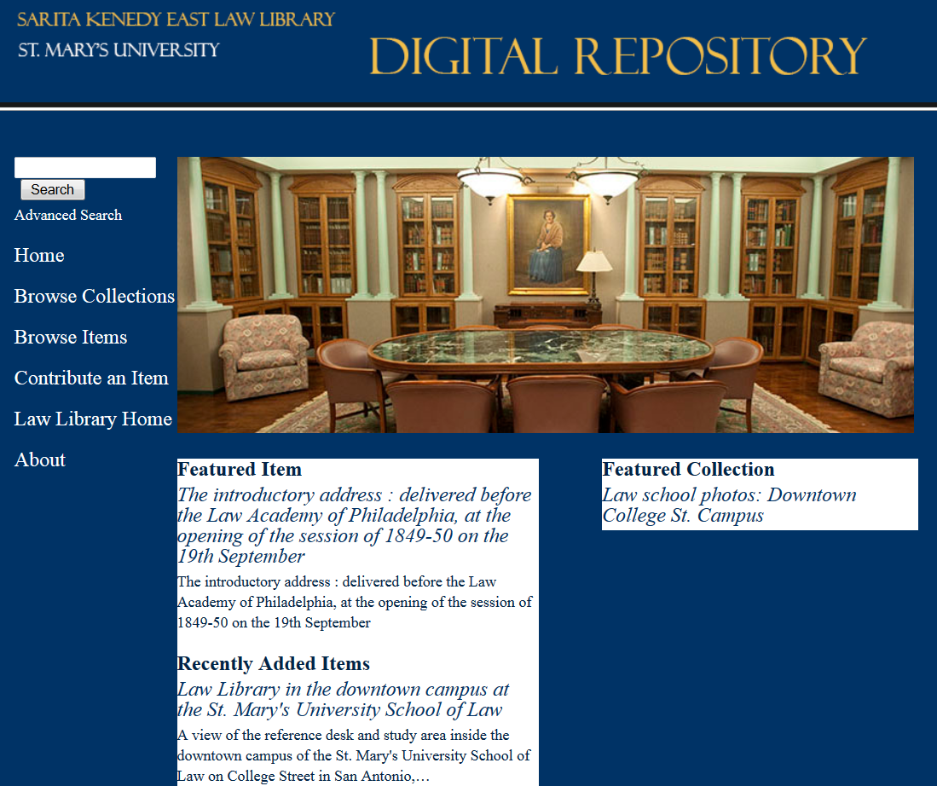
Institutional Repository in Omeka
Platform to display digital objects and share metadata
OAI-PMH repository capabilities
Omeka install
Light server requirements
Good for access
Bad for preservation
Notes:
Tour of repository
Key points:
No preexisting digital projects at the law library. A goal for this is to collect material, then reassess and move to a more robust platform.
Open source was available to accomplish this task.
This project had the huge con of being free-as-in-puppy. It took a lot of staff time to set up. Some of that would go to any platform: looking at platforms and choosing one, collecting material and creating metadata, etc. Some is special to implementing open source in house: configuring the backend (plug ins are things that add functionality to the platform; I selected then installed those and for one of them I had to debug it), configuring the layout (hosted solutions often give you a web developer to go back and forth with and choose layout, color scheme, etc).

Slide 45
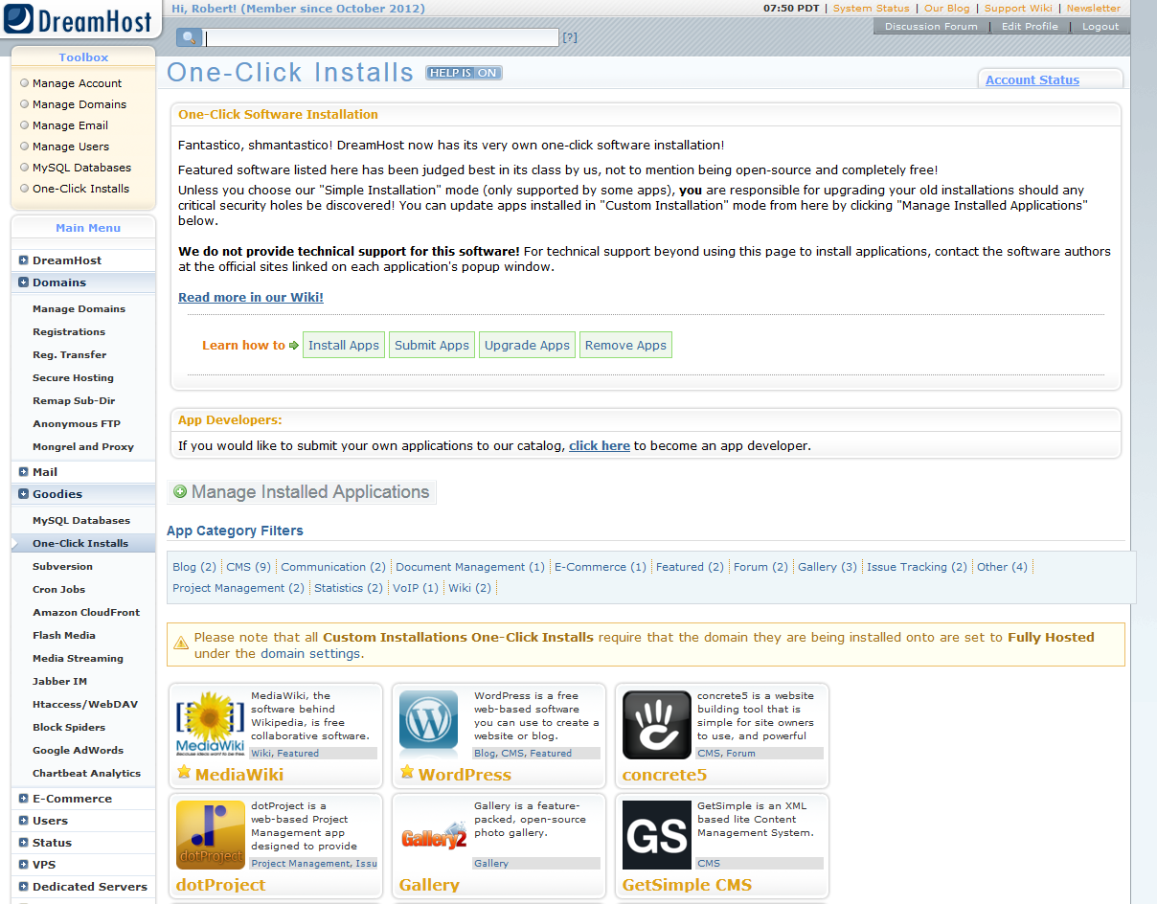
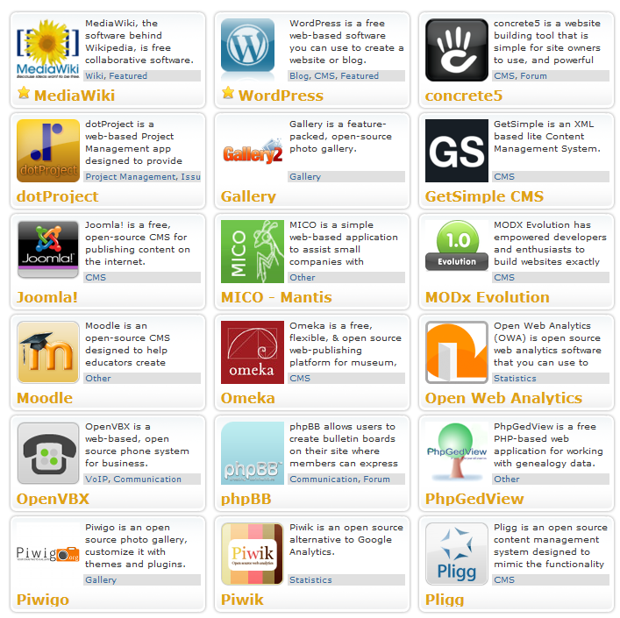
Cheap hosting: Comes with Open Source
Notes:
These are one-click installs available through Dreamhost. You don’t need to use Dreamhost to get these. Almost any server will have them.

Slide 46
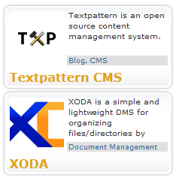
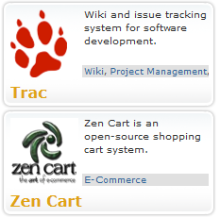
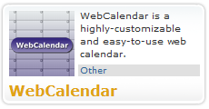
One-Click installs with cheap webhosting
Notes:
Here are one click installs on Dreamhost.

Slide 47
Open source: Free-as-in-puppy
Things that get hard:
Troubleshooting. How do I add this tiny little feature?
Backups. How do I make a backup? You really have to understand the backend to do this right.
Easy to make something quickly.
Hard to ensure long term existence.
Notes:
You pick how it looks, and often you can do that right from the program. If not, then there will be a website of themes, and you just look at them then pick one you like.

Slide 48
Open source Web Development
Pros
No up front or ongoing money allocations for new projects (many projects can run on one server)
Cons
Can be free-as-in-puppy; can take significant staff time to set up and maintain.
Security and backups are all in house; can be risky.
Not enough technology skills in the law library community to quickly replace staff.

Slide 49
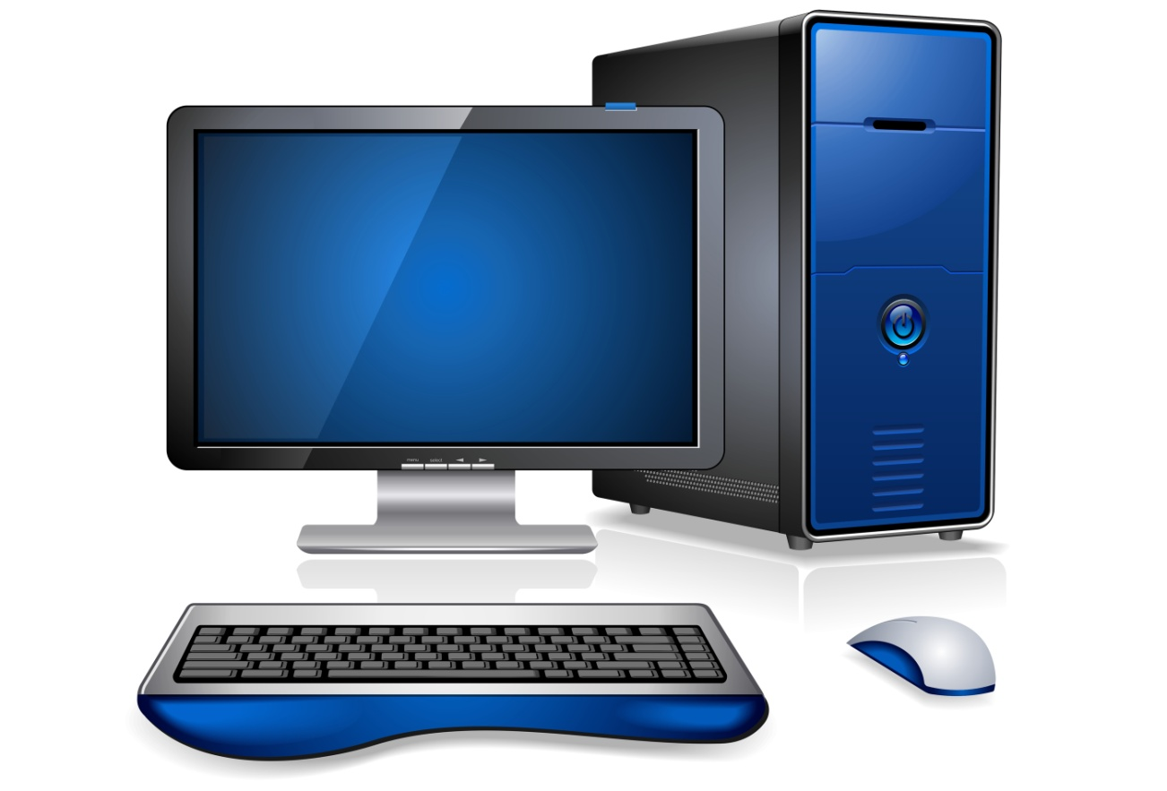
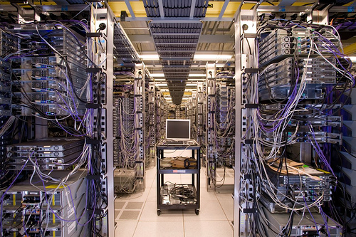
Applications
Servers

Slide 50
Open source Platforms vs Applications
Desktop Applications: Payoff for all
Same amount of time to learn how to use open source software.
More documentation required for proprietary: Must track licenses for each install.
Platforms: Complex tradeoffs
Vendor run products are often very expensive. $1,000s per year. Vendor lock-in is costly.
More technical skill is required to do your own. (Still some technical skill to configure a vendor’s product.)
More documentation required for open source: Must keep configuration notes.

Slide 51
Open source Platforms vs Applications
Fewer hidden costs in proprietary platforms - CMSes, repository platforms, server stuff – (issues with server administration or troubleshooting).
Main benefit of open source is you can get a service plan or consultant, and there is competition there. No vendor lock in with open source.
Fewer hidden costs in open source desktop applications (issues with tracking licenses or finding install CDs 2 years later).

Slide 52
Any questions?

