Slide 1
Goodbye books, Hello database: Access to justice issues for pro se litigants as legal research goes entirely online
Wilhelmina Randtke
www.randtke.com
LSC TIG Conference
January 2015, San Antonio, TX

Slide 2
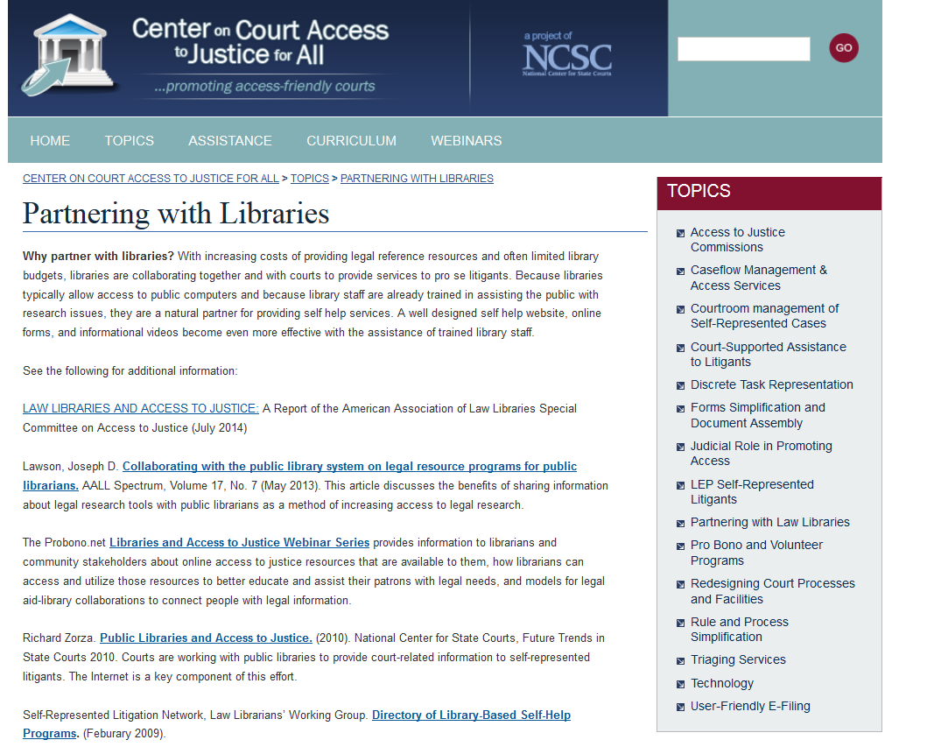
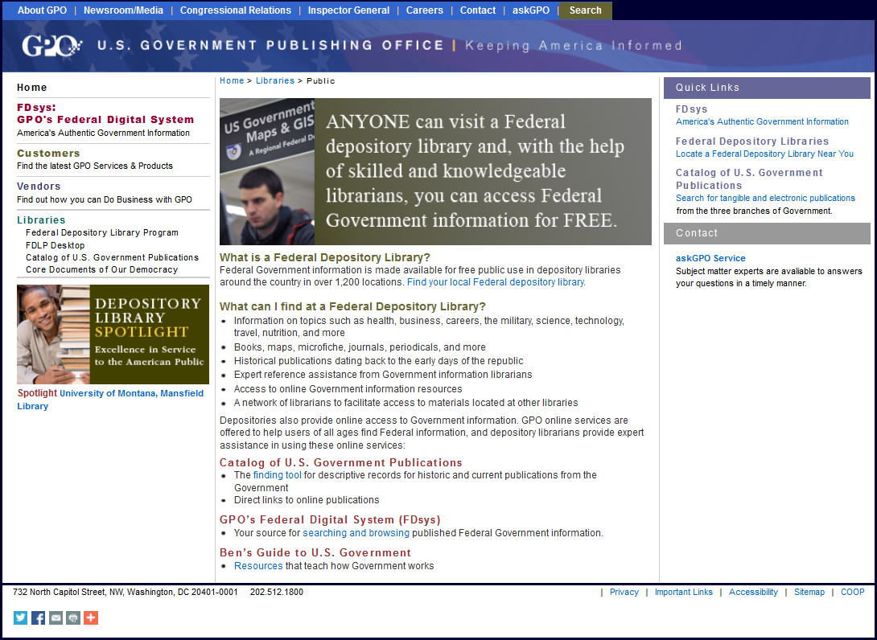
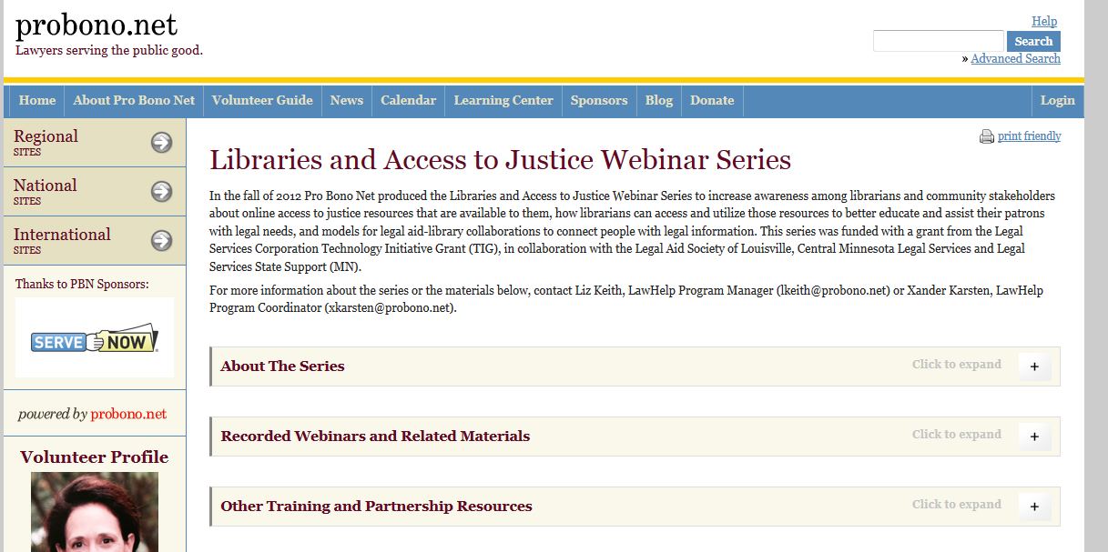
Law Libraries and Access to Justice
Notes:
These are some groups that acknowledge law libraries as having a role in access to justice – the Government Printing Office, the National Center for State Courts, and Probono.net .
Law libraries can help pro se patrons do self help. For anyone involved in a legal process they can help that person get educated. And they often provide internet access. 44% of people under the poverty level sometimes get internet access through a public library.

Slide 3
Where are law libraries in the shift from print to electronic?
Notes:
This presentation will try to give a feel for where law libraries are in the switch to digital materials.
First I’ll share pricing info and preliminary results of a study my colleague Stacy Fowler and I are doing on the shift to electronic books in law libraries across the US where we've phone called and interviewed law libraries across the US about where each is in the shift from print to electronic.
Image credit: Licensed CC0 by Nemo on Pixabay http://pixabay.com/en/lcd-screen-television-monitor-book-40304/

Slide 4
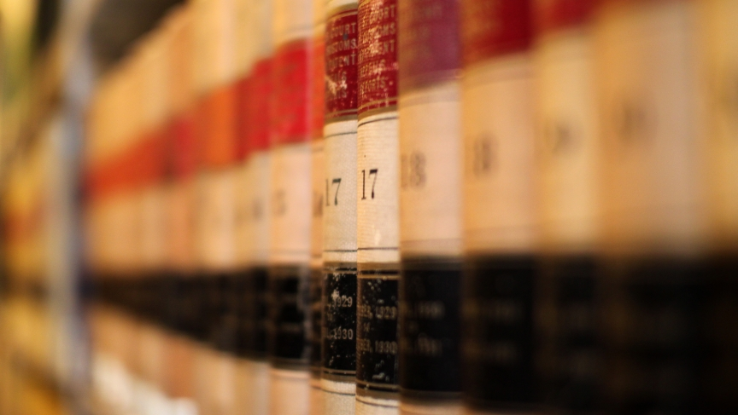
$$
$
$
$
$
$
Notes:
We’ll start first with the money. This shows prices of printed regional reporters since 1998. You can see the price about doubled from 1998 to 2004, then doubled again from 2004 to 2009, then doubled again from 2009 to 2013. It’s a very steep price rise.
Info is from www.aallnet.org/Documents/Publications/Price-Index/
Picture of reporters is from Mr.TinDC/Flickr

Slide 5
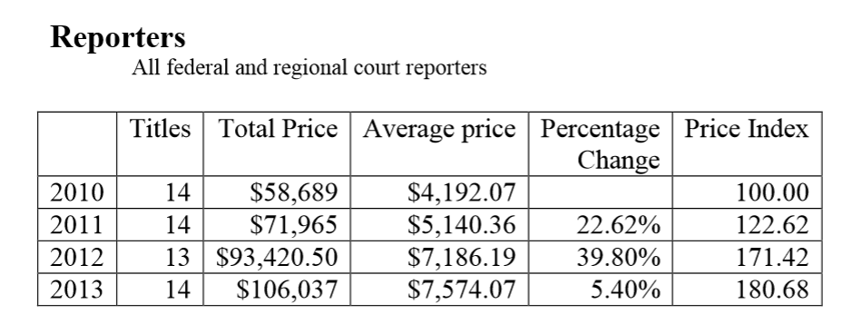
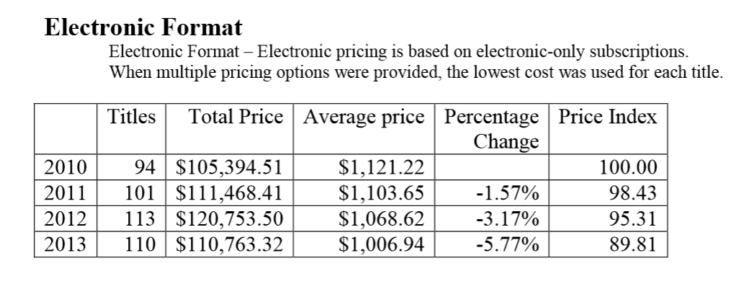
$$
$
$
$
$
$
Source: American Association of Law Libraries, The AALL Price Index for Legal Publications 2013 (2014), available at http://www.aallnet.org/Documents/Publications/Price-Index/price-index-2013.pdf.aspx .
Notes:
Meanwhile, pricing for electronic material is basically flat.

Slide 6
$$
$
$
$
$
$
What’s really happening?
Near universal library budget cuts.
Eliminating print books, when something is available online.
Prioritization of law students, and the bar.
Notes:
What you would guess from price info along with a contraction in the legal market is that law libraries would cancel print. And, that's what we found in our study.
These are results of a study I and my colleague Stacy Fowler are finalizing. We interviewed 12 law libraries that are open to the public – 11 academic libraries and 1 county law library. Of those, 7 directly identified the public as a key user group that they serve. So, serving the public was a goal for the law library. Additionally, we interviewed 2 other academic law libraries that were not open to the public but are open to the local bar. Out of these law libraries, all but one had had budget cuts in the past 5 years, about a third had had a pretty dramatic budget cut of to the tune of 20% or more in a year, and all were canceling purchases of new print books. A common strategy was to look at what is in the academic Westlaw and LexisNexis plans and then cancel any print book that is also available electronically to students and faculty, and for the library to only keep print resources for that state.
Right now, budget pressure is accelerating the shift to electronic and to no print. Most literature on the shift to digital talks about a hybrid environment where some materials are print and some are digital. What we suspect is happening is that really print is going away faster than people thought it would, and that this is a reaction to budget pressure, and is not planned.

Slide 7
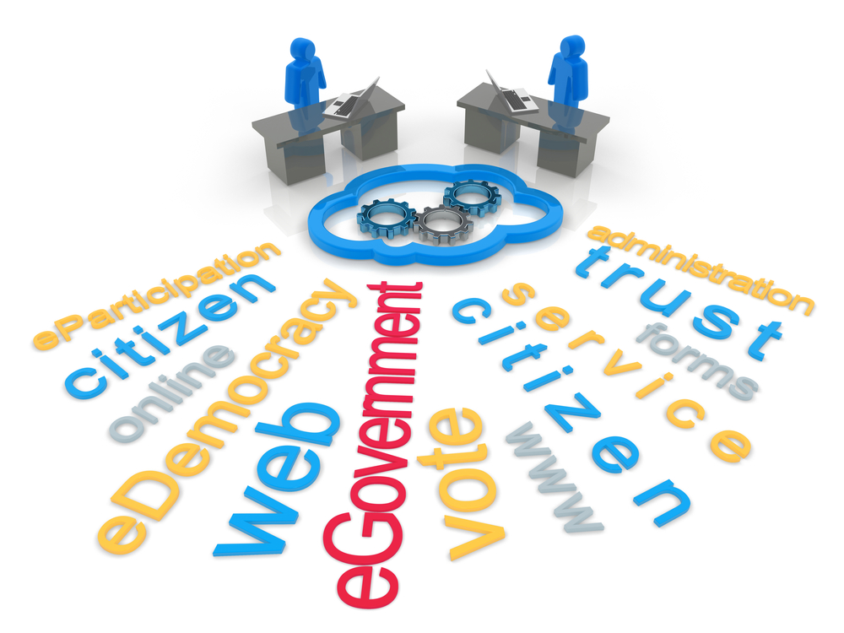
What are the implications of? Online only…
Notes:
First off, having almost no books is not that bad. Government websites, including forms and how to file them, are huge for the average person. The average person does not get much use from regional reporters and all the books lawyers love to stand in front of in law firm photos. So, there is a whole world of new egovernment info that is on the internet that never was available in books.

Slide 8
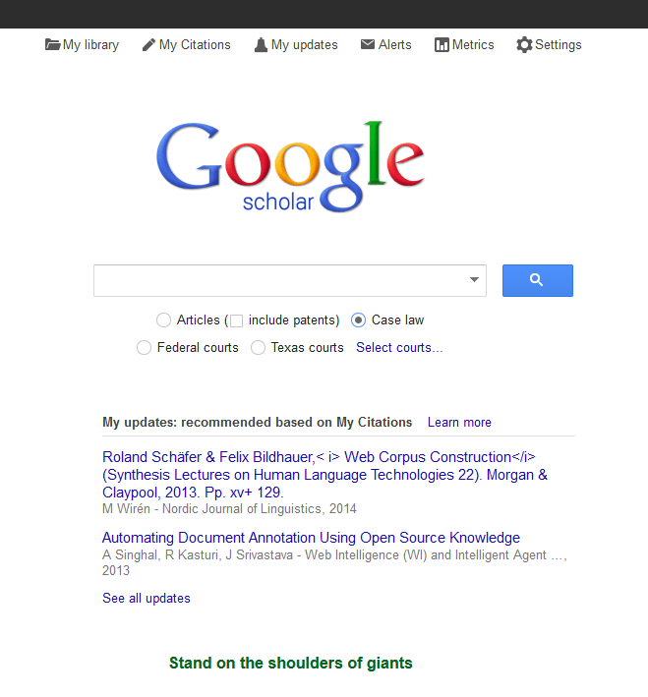
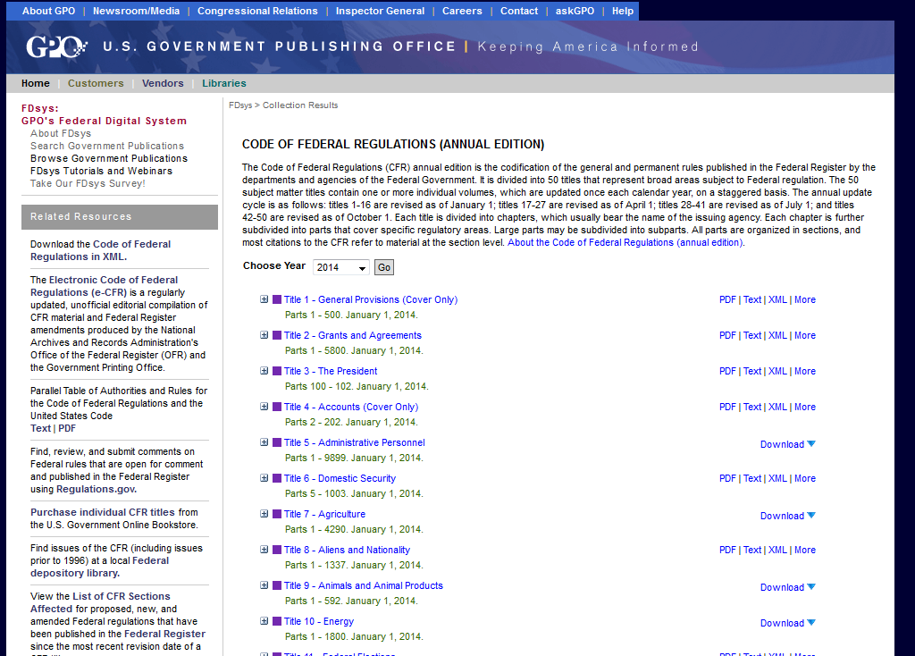
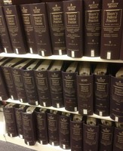
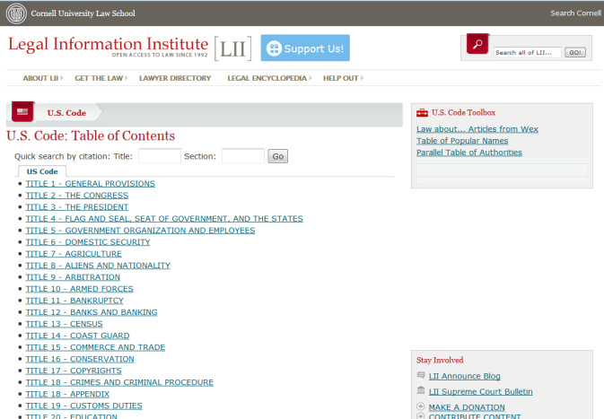
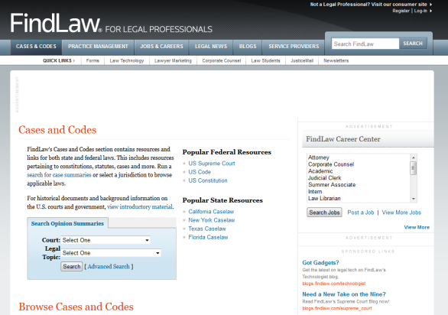
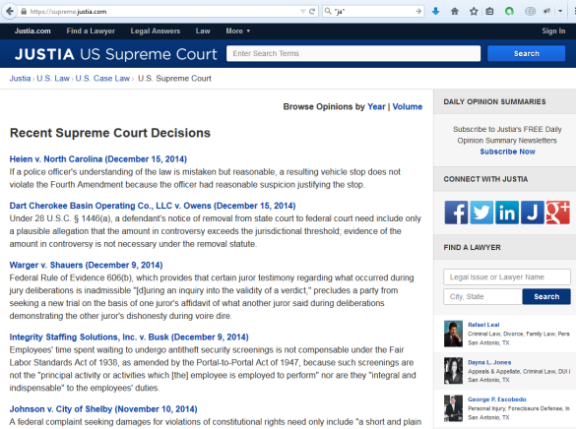
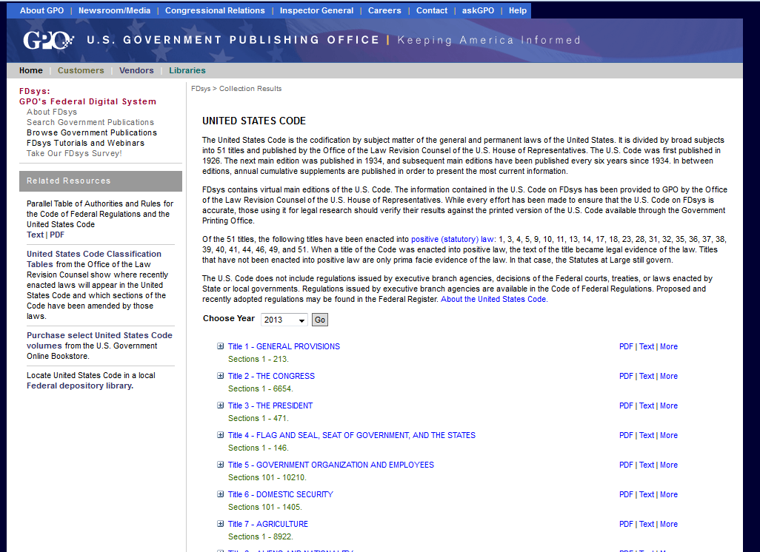
What is free online?
Cases
Statutes
Treatises
Notes:
But from that traditional paper law library, we have to look at what moved online for public access. Cases and statutes are generally available online for free. But, treatises are not. And things like Sheppards and Keycite and ways to interpret that case law are not available online.

Slide 9
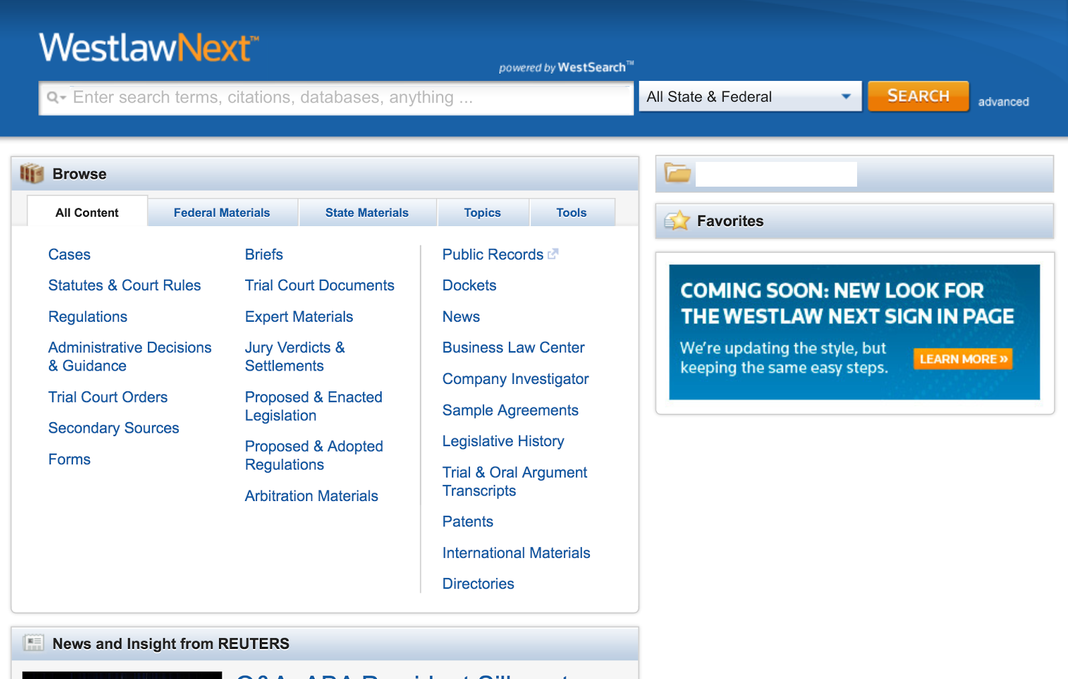
Paywalls…
Notes:
Treatises are available online, but not for free. Libraries can provide treatises to the public is by paying for Westlaw or Lexis access on a single computer, so that anyone coming up to that computer can use the resource. The pricing for this is comparable to paying a person’s salary per computer per year.
Out of the law libraries we interviewed, only 2 of the 12 law libraries that were open to the public had purchased a Westlaw terminal in order to continue providing access to local attorneys and the public.

Slide 10
Notes:
Slide: ???
Law Libraries' role in serving the public: Law libraries matter in that they are one point of contact for pro se patrons. Law libraries also serve practicing attorneys. In our study when we asked about who uses the law library, librarians were much more likely to say members of the bar use the facility, whereas for pro se patrons that was more likely to come up if we asked "Well do you have the public coming in and using your materials?" In the St. Mary's law library, for every pro se patron we have multiple lawyers coming in, often to use form books if they are going into a new type of area.

Slide 11
Notes:
Slide: Picture of a wall
Licensing has a big impact. With books, typically, a member of the bar or member of the public can get full access to that book. They can come into the building and read it, take a photo with their phone, and get that information. Looking back, 5, 10, 15 years ago someone visiting the law library had access to almost everything you could think of. With electronic databases, there may or may not be access for attornies and the public. Each law library electronic database is rented under a contract, and that contract will say who can get into that database and read what's there. The two really key databases - Westlaw and LexisNexis are either available to students and faculty only, or they are through computers where a library can rent access to that computer and then one person at a time can use that computer and that computer costs more than a person's salary each year to provide. Of the law libraries we interviewed that were open to the public, only two had gotten a Westlaw or Lexis terminal in order to replace print and provide access to alumni or the public. So the other 12 law libraries just no longer provide access to legal treatises if they stopped carrying an up to date book.

Slide 12
Notes:
Slide: Picture of a wall
The first, and obvious implication is that pro se patrons and lawyers can't get as much information. All government websites and online services are new extra services, but they are no longer in addition to books. Instead those free of charge online materials may be the only material that the library can provide to a pro se patron.

Slide 13
Notes:
Slide: Screenshot of Westlaw on one side, image of NOLO logo on the other, image of A2K or something like that
Implications: On the plus side, for pro se patrons, a lot of what is going away is not the absolute most useful info for the public. A significant chunk of law libraries we talk to consciously want to serve the public. All want to serve the bar. LSC has done some projects to recommend collections and resources to serve pro se patrons, and there may be a good openning now where libraries percieve that something is lost and want to go ahead and serve and so are more open to looking at those resources.
That's your positive. But there are many negatives.

Slide 15
Notes:
Slide: ???
With an all electronic world, you have the extra need for people to be computer literate. You always have the barrier that law is complicated, and the person needs some way to navigate that. For pro se you sometimes have the barrier of actual literacy. Now, you have the barrier of computer literacy and the fewer books in the library the less I can work around that. Even something like reading an FAQ on a government webpage can be difficult for someone who doesn't know how to scroll down or who keeps minimizing the browser window and thinking it's gone. Here in town, the public library provides computer literacy classes, and I end up printing that schedule and giving it to pro se patrons as frequently as I do printing off information about the state bar's lawyer referrral.

Slide 16
Notes:
Slide: ???
Implications for lawyers and people working to serve the needs of the poor are different. Typically, lawyers are able to get the computer skills. They will take a class if they have to. And lawyers are able to get the legal materials. Every bar in the US provides Fastcase or Casemaker, or both, so lawyers have primary law. Those treatises, though, are going away to where a lawyer who doesn't have it through work doesn't have it. And for people working with legal issues who are not bar members, that access is going away. For example, one use of the St. Mary's law library was for someone working with battered women to update a manual on use of force in self defense for battered women. This person isn't a member of the bar, so doesn't have Fastcase or Casemaker and that's a volunteer effort so this person isn't going to be able to rent electronic access at a high monthly rate to be able to update that manual. In a print world, we can still provide treatises, but as those disappear, we won't be able to do that.

