Slide 1
Copyright, 3D Printing, and the Value of Open, Vetted 3D OER
Lee Bareford
Head of the Learning Commons
Georgia Southern University Libraries
Savannah, Georgia
John Schlipp
Head of Research Services
Georgia Southern University Libraries
Statesboro, Georgia
Wilhelmina Randtke
Head of Systems and Technologies
Georgia Southern University Libraries
Statesboro, Georgia

Slide 2
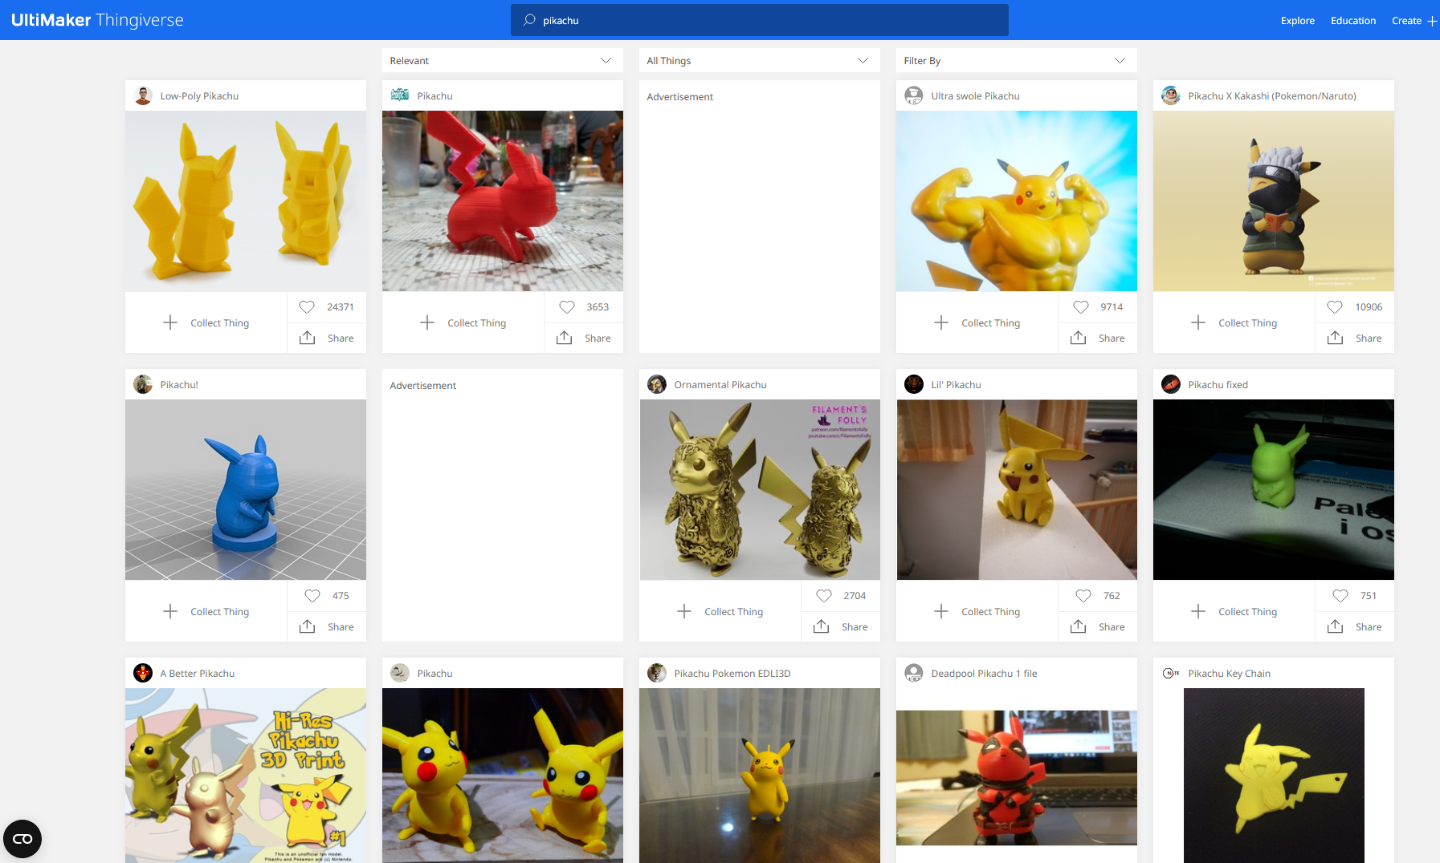
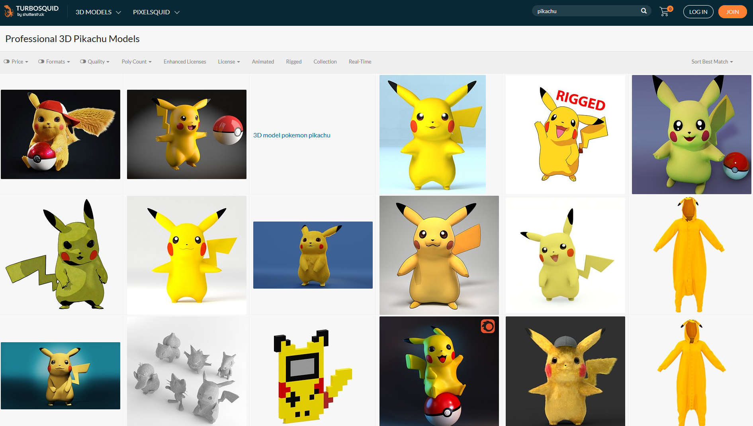
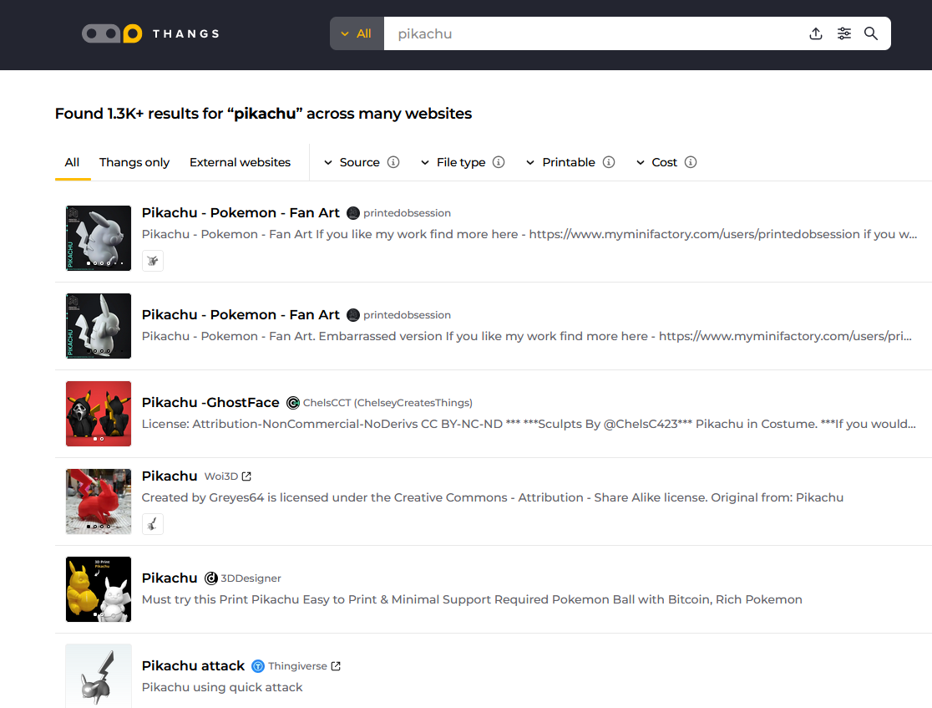
Introduction
Did you pre-register for the free
3D printed Pokemon?

Slide 3
Session Goals
Examine limitations and concerns about self-serve 3D printing in libraries
Explore U.S. Copyright Law and potential liability libraries hold when offering 3D printing services
Outline issues with copyright and infringement in the 3D printing community
Review examples of vetted 3D models currently available online
Discuss the benefits of creating OER repositories of vetted 3D models

Slide 4
3D Printing vs. Conventional Printing Concerns
Self-serve printing affords copyright protections, but:
3D printers can be damaged or uncalibrated due to tampering
3D printers are finicky and require expertise to operate effectively
3D print jobs take hours to complete and must be monitored
Troubleshooting 3D print errors requires expertise
3D printing materials can be hazardous and must be regulated
3D print model files are often copyrighted intellectual properties (IPs) and library may be liable for copyright infringement

Slide 5
Mitigating 3D Printing Concerns
Access to 3D printers should be regulated and limited to trained staff only
Safety guidelines should be documented and prominently posted
A 3D print request system should be established
Effective and efficient 3D printing workflows should be created
3D print files must be vetted for copyright violations by qualified reviewers

Slide 6
Copyright Assessment: Liability – Infringement?
Since 3D printing in MakerSpaces and other similar library services are often mediated and not self service, displaying a notice near the 3D printer based upon the Copyright §108(f)* exemption may not fit well to minimize library liability.
Libraries must assess the risk of printing copyrighted works and rely on permission by the author/rights holder or apply a Copyright §107** fair use analysis.
Need to review related U.S. Copyright Law § 102, 106, 107, 108, and 512 to better understand viable options for liability.
*17 U.S. Code § 108 - Limitations on exclusive rights: Reproduction by libraries and archives **17 U.S. Code § 107 - Limitations on exclusive right: Fair use

Slide 7
Copyright Assessment: So what’s protectable?
Copyrighted subject matter § 102* is automatically protected if and when:
Original work of authorship
With a modicum of creativity
Fixed in a tangible medium of expression
Copyrighted CAD software designs from a repository or copyrighted physical objects such as a sculptural figures or architectural works are examples of subject matter protected by § 102.
CAD software files could be categorized as pictorial, graphic, or literary works.
*17 U.S. Code § 102 - Subject matter of copyright: In general

Slide 8
Copyright Assessment: Owner’s Rights?
Copyright owner’s exclusive rights § 106* to:
Reproduce the work
Make derivative copies
Distribute copies to the public
Display and perform in public
*17 U.S. Code § 106 - Exclusive rights in copyrighted works

Slide 9
Copyright Assessment: Infringement of Owner Rights?
Potential infringement when a library customers violates any of the exclusive rights of the copyright owner provided by Section 106 without permission:
Reproduce the work
Make derivative copies
Distribute copies to the public
Display and perform in public

Slide 10
Copyright Infringement Possibilities…
CAD design files or software codes copyrighted as pictorial, graphical, or literary works.
Software codes as literary works for copyright registration.
CAD files could be copyrighted or shared as open source code.
Physical 3D objects copied such as toy figures or costume jewelry are copyright protected as sculptural works.
Most copyright litigation tied to 3D printing deals with the anti-circumvention provision of the Digital Millennium Copyright Act (DMCA).
DMCA “safe harbor” possibly protects libraries from liability only if self service use applies, such as photocopiers and scanners.
Since self service is unlikely, both libraries and 3D printer customers could be liable for potential copyright infringement.

Slide 11
Copyright Assessment: Avoiding Infringement
Limitations on Copyright Owner Rights
Unsupervised copying by users: Signage notice posted near printer §108(f)*
Users uploading infringement material: DMCA “safe harbor” for “online service providers” § 512** does not fit well
Other exemptions: fair use § 107*** more likely application to assess for educational purposes.
*17 U.S. Code § 108 - Limitations on exclusive rights: Reproduction by libraries and archives **17 U.S. Code § 512 - Limitations on liability relating to material online ***17 U.S. Code § 107 - Limitations on exclusive rights: Fair use

Slide 12
Copyright Assessment: Section 108(f)
Ideally, exemptions for libraries in Section 108(f) could apply. It permits libraries and archives to provide copiers and scanners with unsupervised use without liability of copyright infringement, so long as a copyright notice is displayed. Yet such self-service is not feasible with 3D printers as special training is needed to operate.
However, library personnel managing a mediated service should be trained to recognize potential infringement. Copyright awareness and training are vital to monitor and prevent potential infringement by the library.
There is no liability for copyright infringement upon a library or for its employees:
For the unsupervised use by others
Of reproduction copying equipment located on its premises
If a Section 108(f) notice is displayed regarding the making of a copy may be subject to copyright law
Copyright awareness: Although, Section 108 does not apply for mediated copying by library personnel. The use of 108 notice may evidence good faith on behalf of the library. Such notice supplements related copyright policy or procedures by informing customers of the potential risk of infringement associated with their request.
UCLA Library: Mediated Copying https://www.library.ucla.edu/about/policies/policy-regarding-mediated-copying/

Slide 13
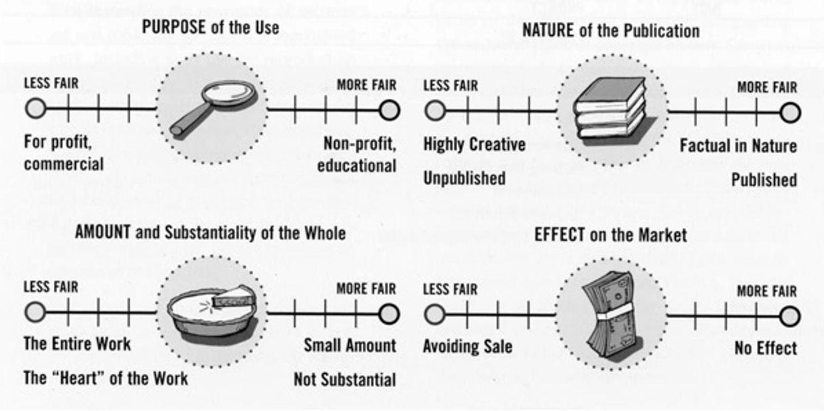
Copyright Assessment: Section 107* Fair Use?
Since 3D printing in a library is usually a mediated service, having a specific copyright policy or procedure in place which assesses an infringement risk should include the right to refuse a customer request. Before refusal, this leaves two viable options for consideration to proceed with customer request:
Get permission from the copyright holder/author
Conduct a fair use analysis
Fair Use* is determined on a case-by-case basis
Analysis based upon four factors: PANE acronym…
*17 U.S. Code § 107 - Limitations on exclusive rights: Fair use
Fair Use Continua image by Carrie Russell from Complete Copyright: An Everyday Guide for Librarians, 2004, American Library Association. Image under a Creative Commons BY Attribution Only License.

Slide 14
Copyright Assessment: Additional Fair Use Questions
Discussion about library actions as fair use
In which scenarios would you need to apply fair use for 3D printing services?
Is fair use possibly tied to educational purposes? Pedagogy of instruction?
Do you have related copyright policies and procedures in place?
How does your library or archive address fair use in other situations?
Other considerations?
Popular trademarks, e.g. cosplay derivatives and fan fiction
Verifying patented inventions, e.g. replacement parts
Privacy and freedom of expression issues
Safety issues too

Slide 15
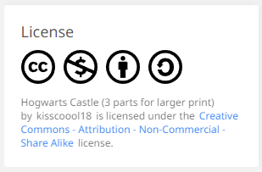
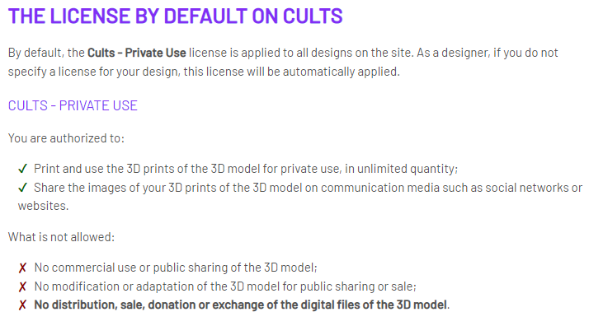
Infringement in the 3D Printing Community
Infringement is rampant on 3D printing websites
Thingiverse.com
Cults3D.com
MyMiniFactory.com
All3dp.com
Websites assume content contributors own the copyright
Anyone can adopt a CC license, even if they do not own the design

Slide 16
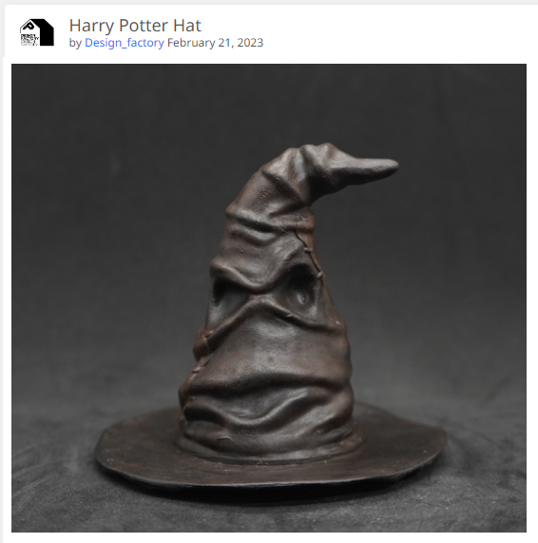
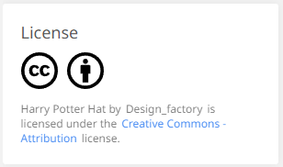
An Example of Infringement
Featured design on Thingiverse.com’s homepage: the Sorting Hat aka “Harry Potter Hat”
Free download
Not licensed by the copyright holder, Time Warner

Slide 17
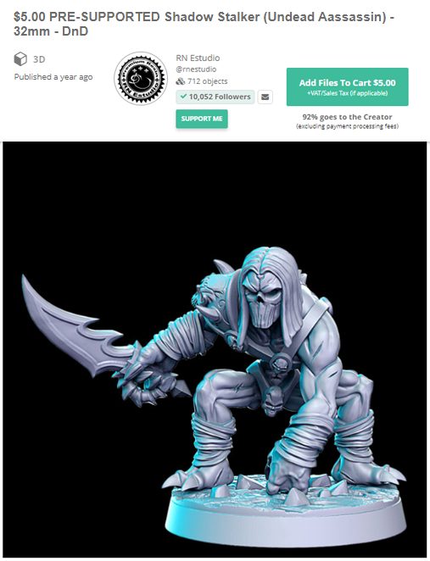
A Subtler Infringement Example
A subtle adaptation of the “Death” character from the Darksiders video game
Paid download from MyMiniFactory.com
Not licensed by the copyright holder, Vigil Games
Vigil Games character concept art

Slide 18
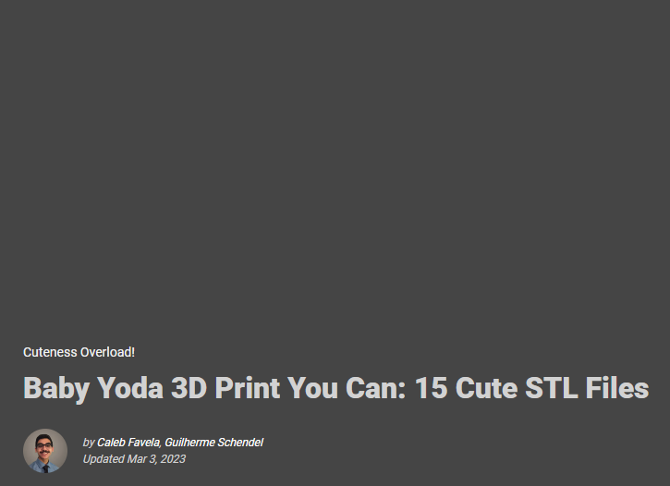
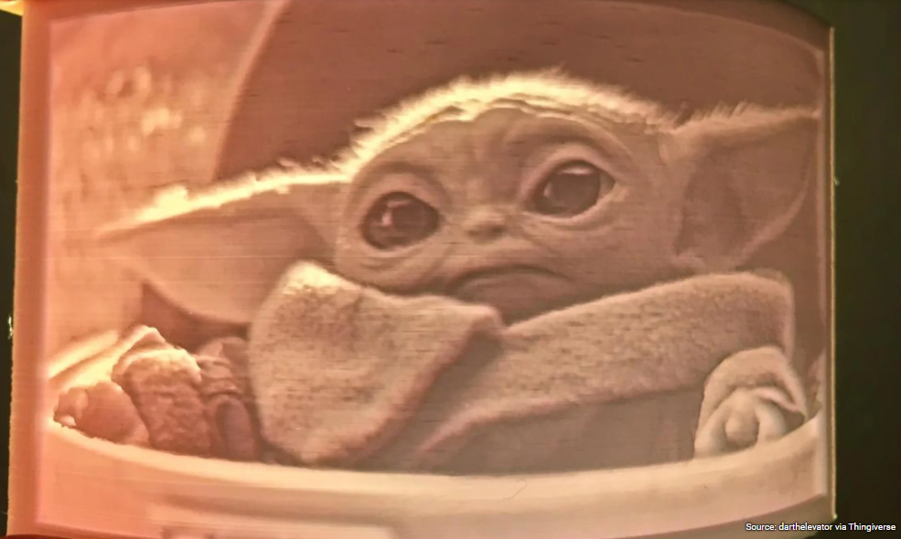
Infringement in Featured Stories
A featured story on the All3dp.com website homepage
Note the image attribution!
Baby Yoda not licensed in all 15 featured files by copyright holder, Walt Disney Co.

Slide 19
Thingiverse search for openly licensed Pokemon
All of these are CC-BY, and none of them are posted by Nintendo.

Slide 20
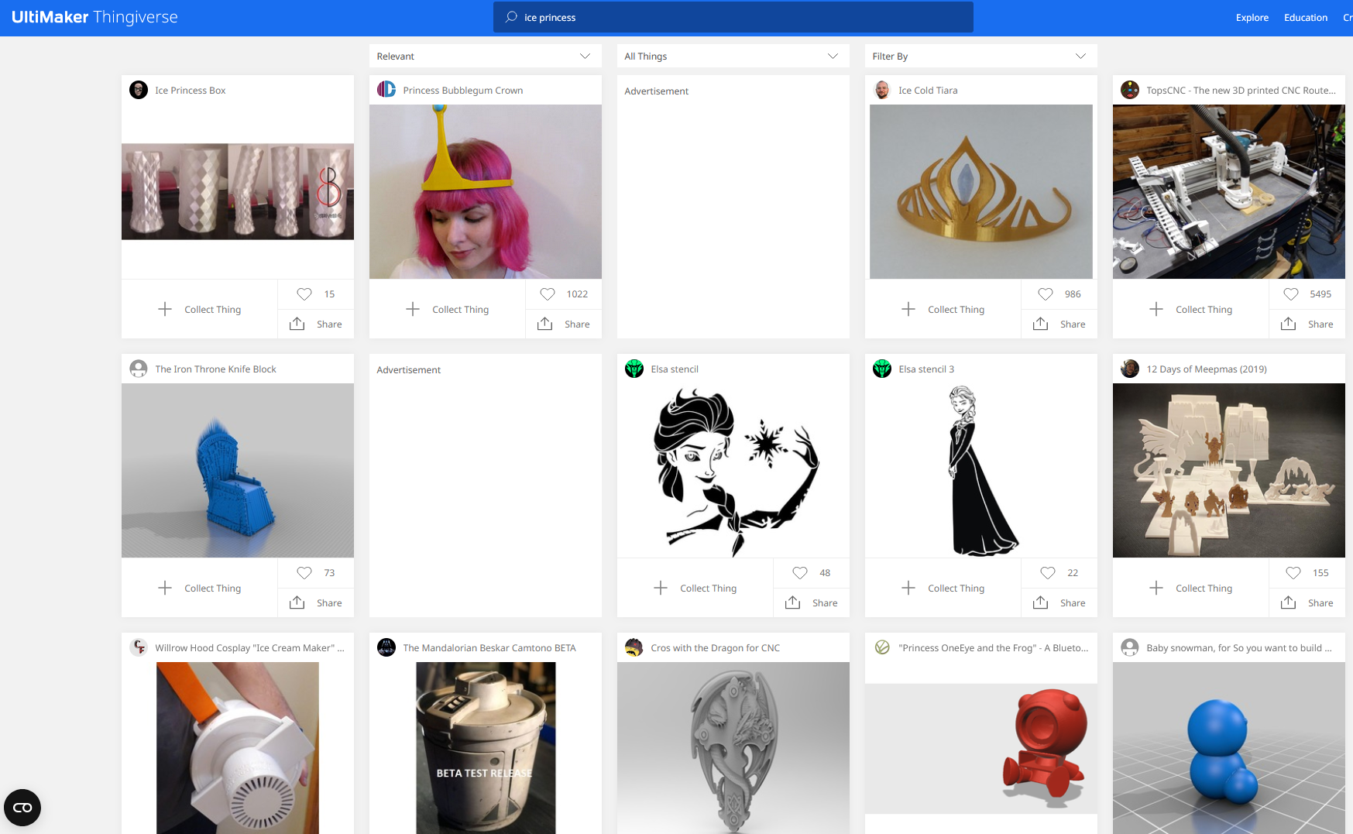
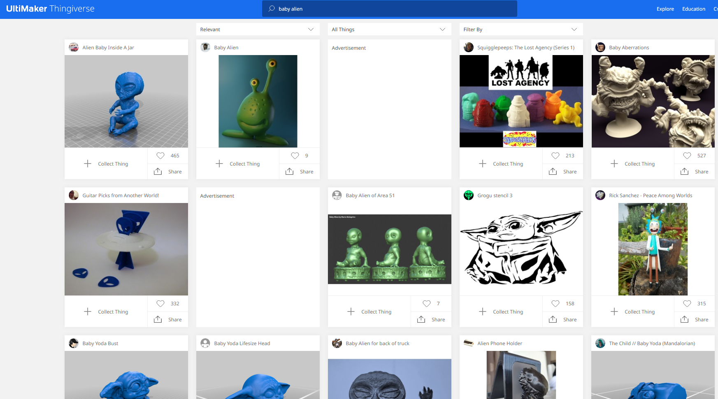
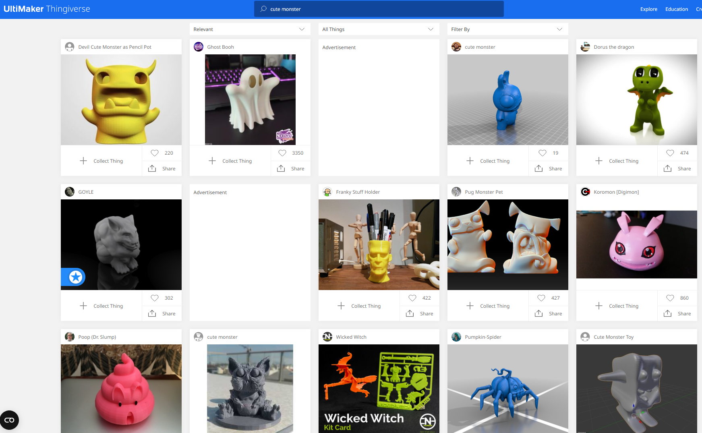
Infringement: Rampant in the 3D Printing Community
“Ice princess” finds Disney’s Elsa from the movie Frozen, CC licensed by user “Longquang”, and her crown CC licensed by user “MerganMcFergan”.
“Baby alien” finds Disney’s Grogu from the show The Mandolorian, CC licensed by user “Longquang”.
“Cute monster” finds Universal Studios’ Frankenstein monster from the movie franchise, CC licensed by user “Martin_S”, and Koromon from Bandai’s Digimon franchise, CC licensed by user “ChaosCoreTech”.

Slide 21
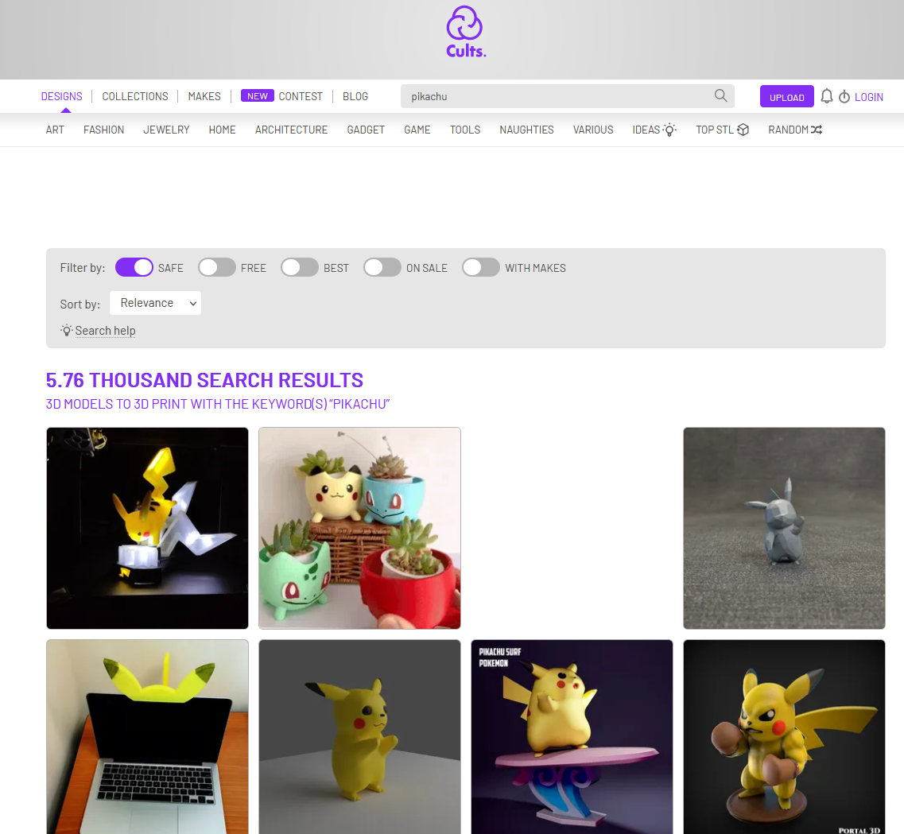
Solution: Vetted repositories
Vetted for these common problems:
Licensing / Copyright (Open)
Technical issues
Problems Problems Problems Problems Problems Problems Problems Problems Problems Problems Problems

Slide 22
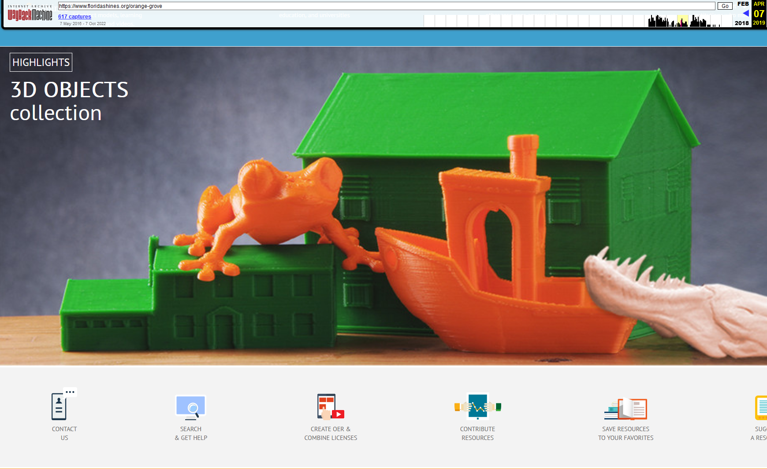
Solution: Vetted Repositories

Slide 23
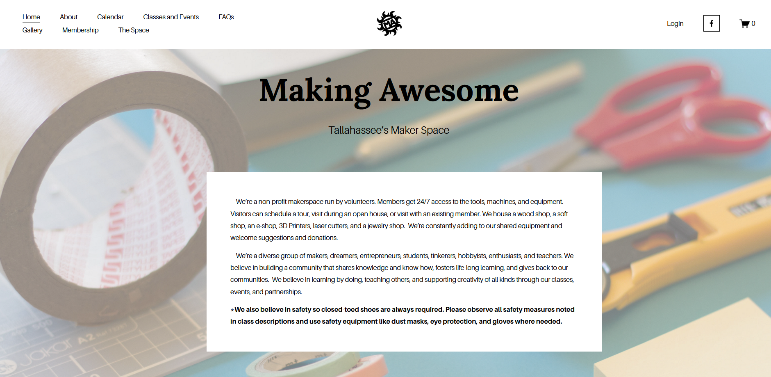

Slide 24
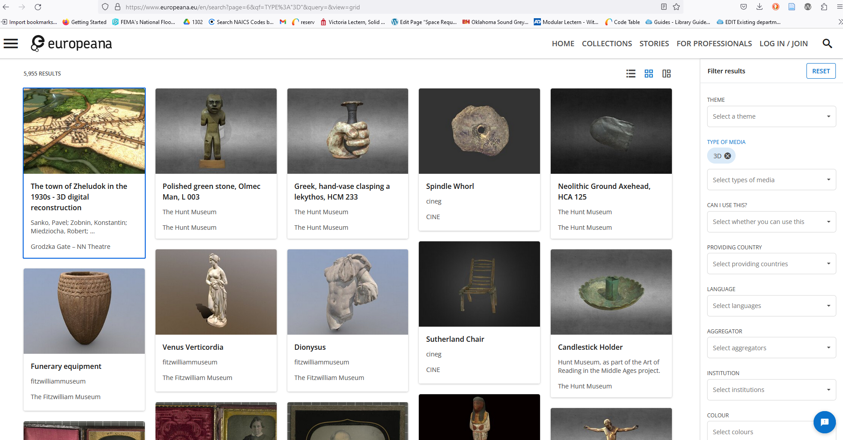
Solution: Vetted Repositories

Slide 25
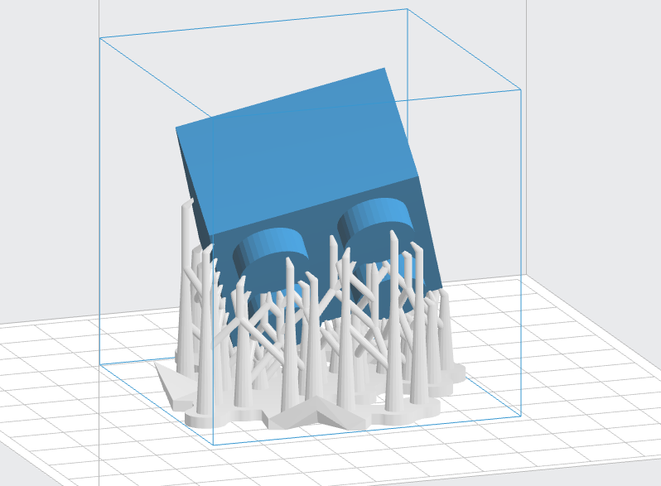
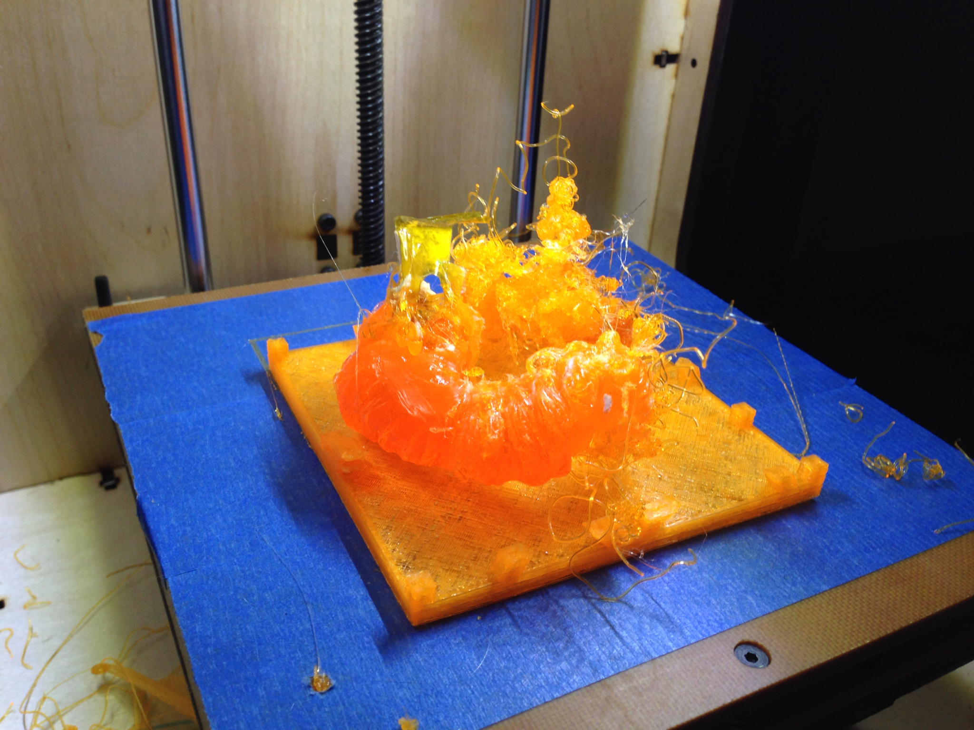
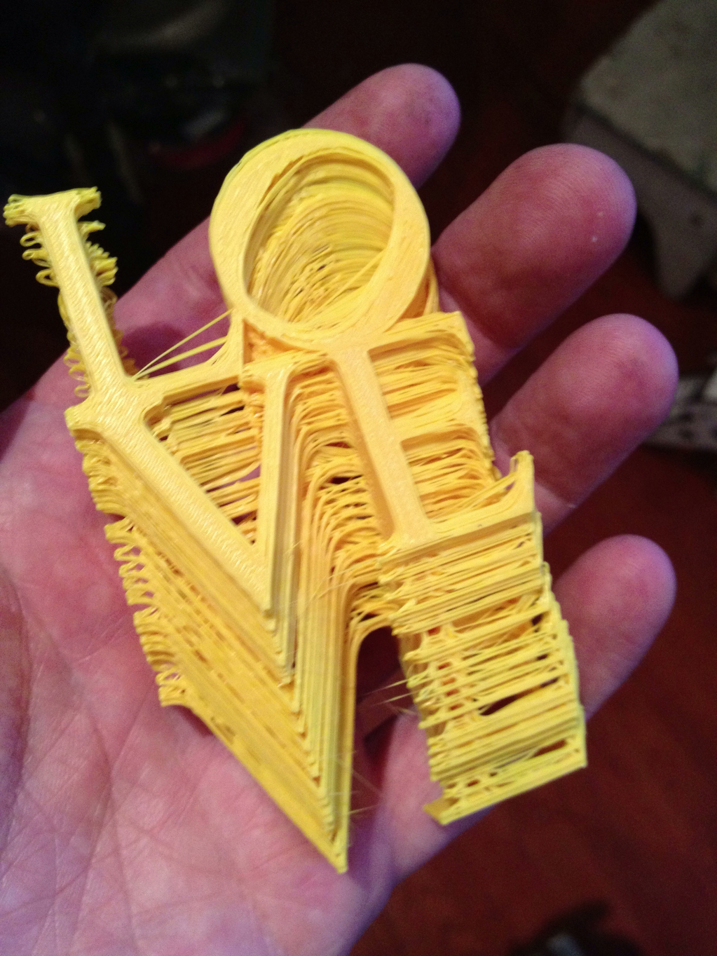
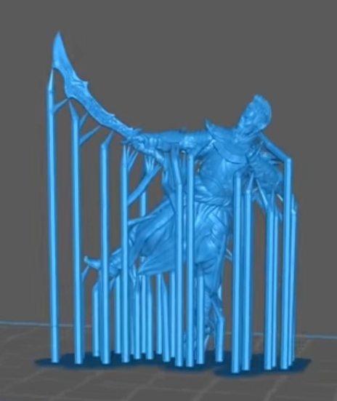
Solution: Vetted Repositories:
Technical vetting
Lego block with supports by PanjalSingh IITDelhi CC-BY-SA from https://commons.wikimedia.org/wiki/File:Supports_in_3D_printing.png .
Orange and blue 3D print fail by John Biehler, CC-BY-NC-SA from https://www.flickr.com/photos/retrocactus/9688874898 .
LOVE print by Fred Kahl CC BY-NC-SA from https://www.flickr.com/photos/fredini/9664696070 .
The blue character is a model sold by Archvillian Games, and the screenshot of the model is from https://www.youtube.com/watch?v=MU0Cq_bjhy4 “3D resin print supports [EASY GUIDE]” by VogMan.

Slide 26
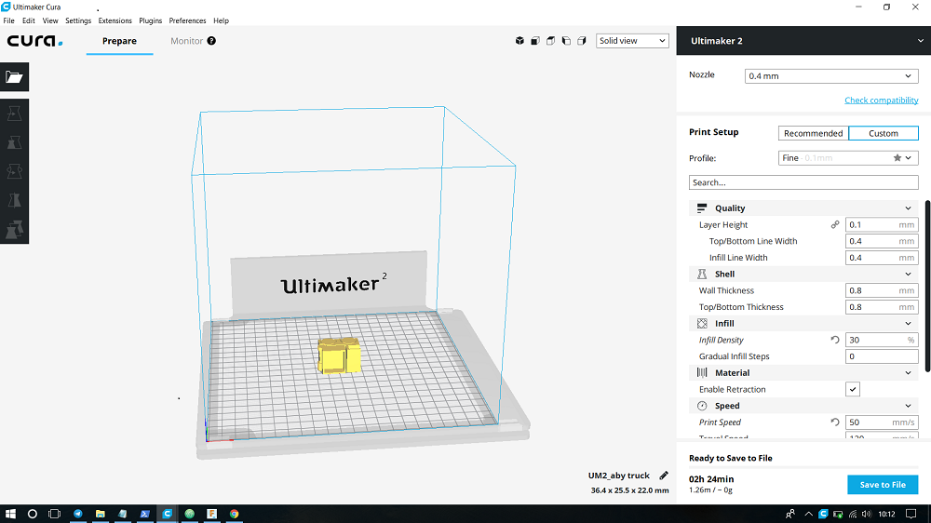
Solution: Vetted Repositories:
Technical vetting
Orange and blue 3D print fail by John Biehler, CC-BY-NC-SA from https://www.flickr.com/photos/retrocactus/9688874898 .
Screenshot of Cura Ultimaker from http://archive.fabacademy.org/2018/labs/fablabtrivandrum/students/aby-michael/Week06/Week6.html blog post by Aby Michael, CC-BY-NC-SA.

Slide 27
Solution: Vetted Repositories: Technical Vetting
LOVE print by Fred Kahl CC BY-NC-SA from https://www.flickr.com/photos/fredini/9664696070 .

Slide 28
Solution: Vetted Repositories:
Technical Vetting
Lego block with supports by PanjalSingh IITDelhi CC-BY-SA from https://commons.wikimedia.org/wiki/File:Supports_in_3D_printing.png .

Slide 29
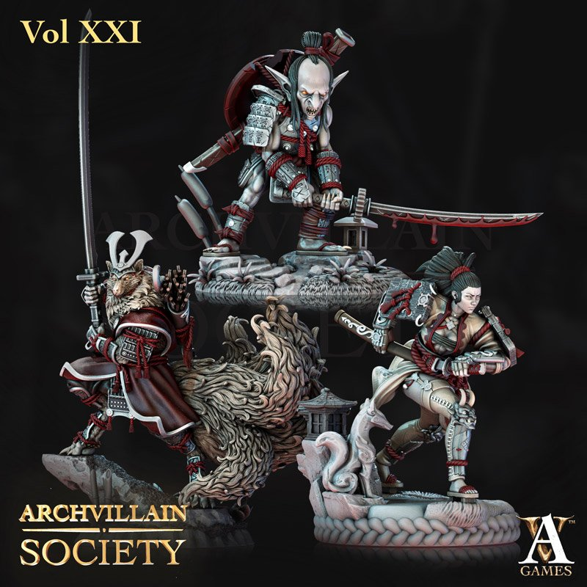
Solution: Vetted Repositories - Technical Vetting
The blue character is a model sold by Archvillian Games, and the screenshot of the model is from https://www.youtube.com/watch?v=MU0Cq_bjhy4 “3D resin print supports [EASY GUIDE]” by VogMan.

Slide 30
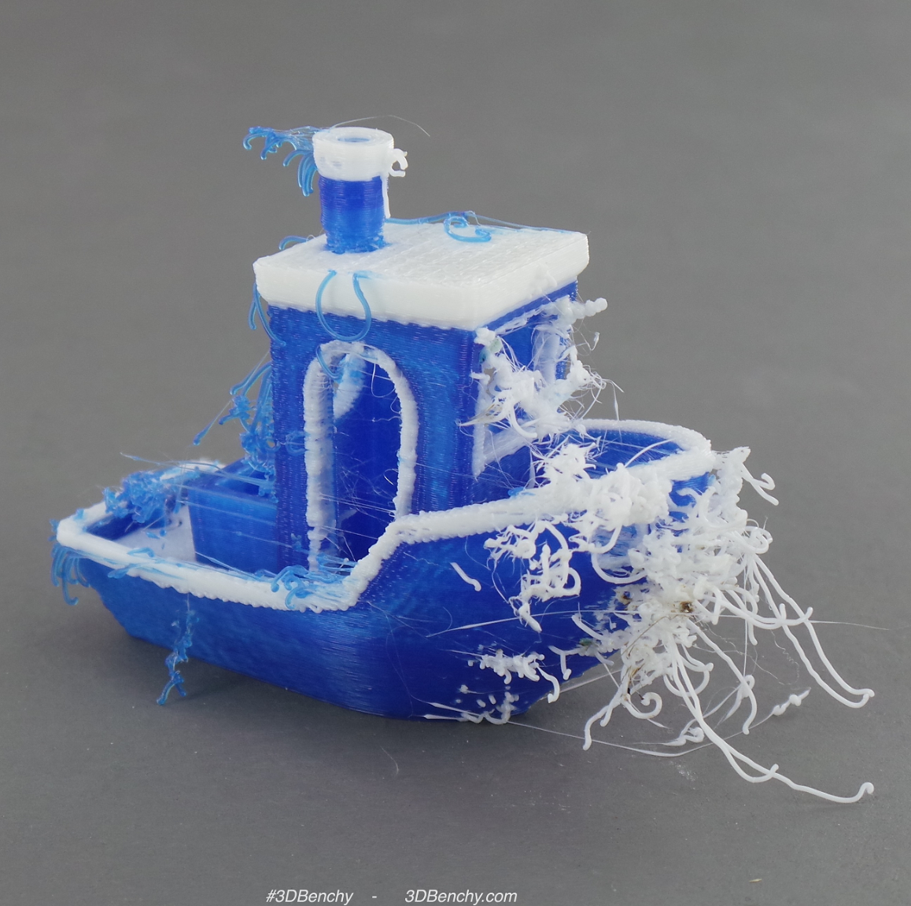
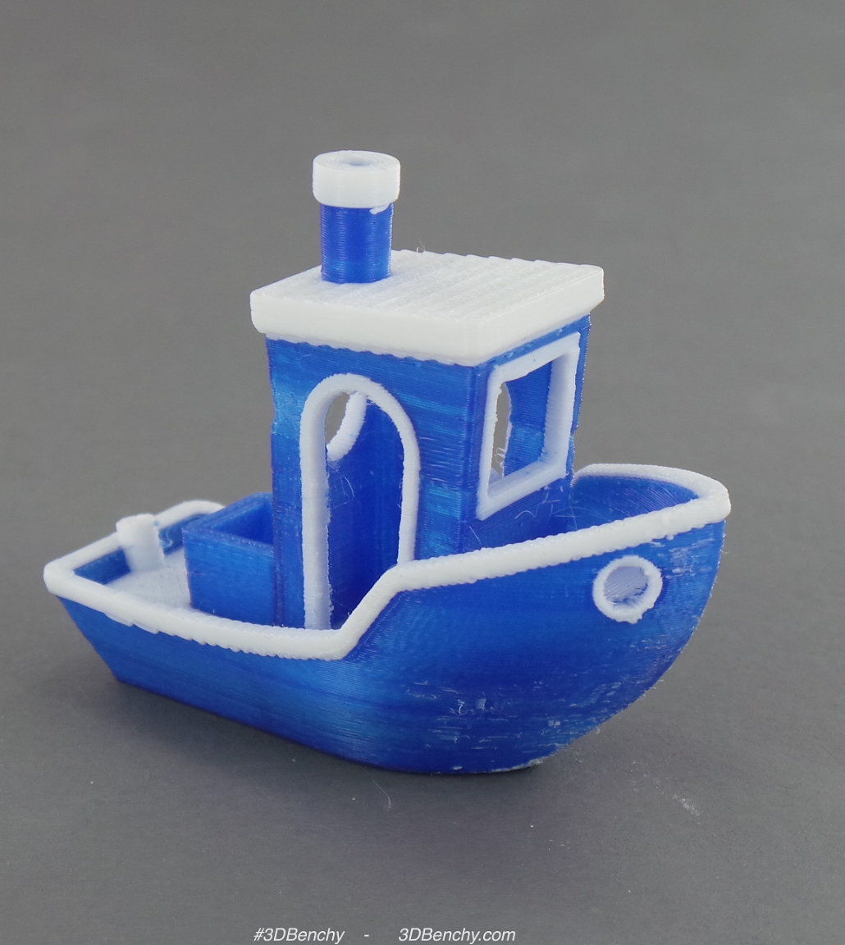
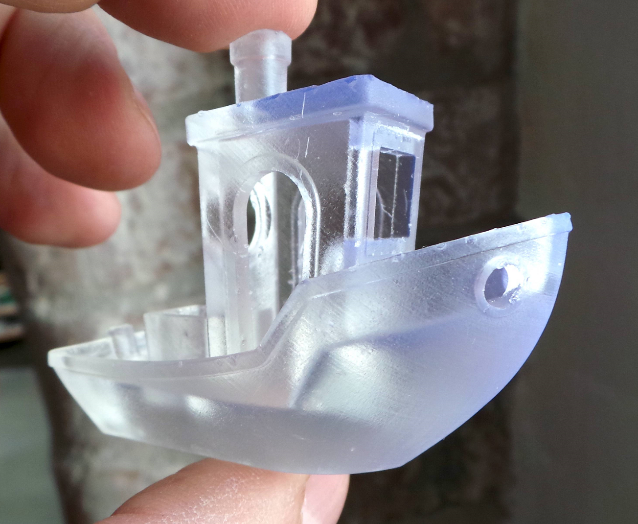
What a difference technical issues make!
All pics of the boat are by 3DBenchy, licensed CC-BY and available on Flickr ( https://www.flickr.com/photos/3dbenchy/24614369271 and https://www.flickr.com/photos/3dbenchy/19672643310 ).

Slide 31
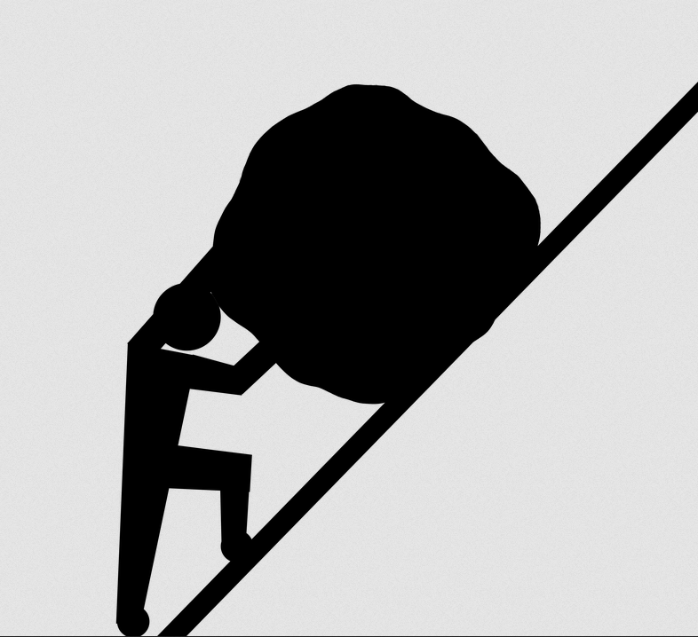
Solution: Vetted repositories
Vetted for these common problems:
Licensing / Copyright (Open)
Technical issues
Sisyphus pic by jalandas0, licensed through Pixabay license, from https://pixabay.com/es/illustrations/lucha-empujar-cuesta-arriba-batalla-1271657/ .
All pics of the boat are by 3DBenchy, licensed CC-BY and available on Flickr ( https://www.flickr.com/photos/3dbenchy/24614369271 and https://www.flickr.com/photos/3dbenchy/19672643310 ).

Slide 32
Solution: Vetted repositories
Vetted for these common problems:
Licensing / Copyright (Open)
Technical issues
Problems Problems Problems Problems Problems Problems Problems Problems Problems Problems Problems

Slide 33
Solution: Vetted Repositories

Slide 34
Solution: Existing Vetted Repositories
What’s available online now:
Smithsonian 3D
https://3d.si.edu/
NASA 3D Resources
https://nasa3d.arc.nasa.gov/
National Institute of Health 3D
https://3dprint.nih.gov/
MyMiniFactory Scan the World https://www.myminifactory.com/scantheworld/
The Metropolitan Museum of Art @ Thingiverse
https://www.thingiverse.com/met/designs

Slide 35
A 3D model likely to fail due to lack of support…
Image source: https://3d.si.edu/object/3d/mammuthus-primigenius-blumbach:341c96cd-f967-4540-8ed1-d3fc56d31f12

Slide 36
Solution: Build Your Own Vetted Repository
Decide on a platform, e.g. WordPress, LibGuides, Digital Commons
Identify personnel who can vet models for OER
Locate or train personnel on technical aspects of 3D printing
Review existing OER repositories, e.g. Florida Orange Grove: https://bit.ly/3JxcbAc

Slide 37
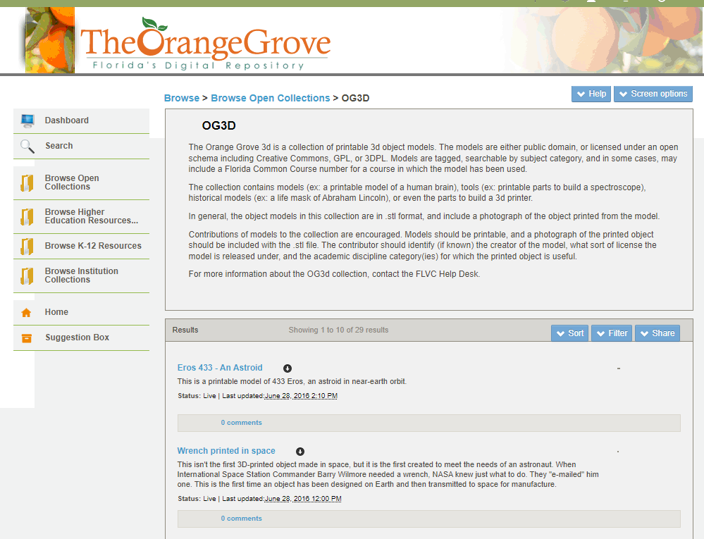

Slide 38
Advocacy for Vetted 3D Model Repositories
We are advocating for libraries to establish their own vetted repository or form/join a consortium that offers access to one
3D model repositories containing vetted files fulfill a clear need for libraries providing 3D printing services
Vetted repositories relieve the burden of copyright liability when clear protocols for inclusion are defined and followed

Slide 39
Questions?
Wilhelmina Randtke
wrandtke@georgiasouthern.edu
John Schlipp
jschlipp@georgiasouthern.edu
Lee Bareford
nbareford@georgiasouthern.edu

