Slide 1
From RAG to Riches?
Corporate Control in the AI Research Era
Wilhelmina Randtke, Nikki Canon-Rech, Kevin Reagan
Charleston Conference, Charleston, South Carolina, November 15, 2024
Notes:
Introductions: I’m WIlhelmina Randtke. I’m currently Head of Technologies and Systems at Georgia Southern University.
Today I’m talking about RAG, retrieval augmented generation. And… about corporate control of generative artificial intelligence and technology.
My coplanners Nikki Canon-Rech and Kevin Reagan are not here today.

Slide 2
Abstract
Search engines tout retrieval augmented generation (RAG) as the future of search. There are popular and academic interests in generative artificial intelligence (AI), and how it can enable new methods of research. RAG provides a way to mitigate AI misinformation and improve results. RAG also raises ethical, commercial, and legal issues that information professionals must address. AI-generated misinformation is subject to consumer protection regulations, though Section 230 protections provide immunity from externally generated, website-hosted misinformation. For instance, Meta is not liable for harmful medical information that users produce on Facebook and Instagram, though Meta would be responsible for harmful medical information it produces. Similarly, copyright law affects RAG differently than traditional search, with implications for library collections and scholarly communication. This presentation explores how RAG impacts academic libraries and the research process:
Challenges in evaluating AI-generated information
Implications for information literacy instruction
Effects on collection development and resource licensing
Potential changes to scholarly publishing models
Ethical considerations for library-provided AI tools
This presentation examines how centralized corporate control of AI technology influences academic research and library services. By understanding these issues, librarians can better advocate for responsible AI use in academic settings and guide researchers in navigating this evolving landscape.

Slide 3
Retrieval Augmented Generation (RAG)
= incorporate search results into a generative AI response

Slide 4
RAG solves common problems with generative AI

Slide 5
Misinformation: Generative AI makes things up
RAG can compare against real world info
Image: https://commons.wikimedia.org/wiki/File:AI_generated_woman_with_extra_legs.jpg licensed CC-SA-4.0 by Mikko Paananen
Notes:
Problem: Misinformation: Generative artificial intelligence tools will make things up.
RAG assist: By comparing a response against a search engine, misinformation can be internally censored.
Photo of lady with extra legs is from https://commons.wikimedia.org/wiki/File:AI_generated_woman_with_extra_legs.jpg licensed CC-SA-4.0 by Mikko Paananen.

Slide 6
Background on high training costs
GPT = Generative Pre-trained Transformer
Training is expensive
GPT 3 training cost = over $12 million
Hugging Face’s BLOOM training cost = around $10 million
Training requires specialized hardware:
Training GPT4 took 10,000 NVIDIA chips. (fancy, specialized, more than consumer grade chips)
Experts oversee the training process
Notes:
GPT stands for Generative Pre-trained Transformer. Pre-training is an extremely resource intensive process. Unlike a hard coded algorithm that has predefined decision points, a machine learning algorithm has pattern recognition to let it process data, and it trains on a set of data to begin recognizing patterns. Pretraining involves processing a whole bunch of data and finding patterns in it. For a chatbot, that's processing a whole bunch of text written by people.
Training costs are high:
GPT 3 training cost = over $12 million. ( Kyle Wiggers, OpenAI launches an API to commercialize its research, VentureBeat (June 11, 2020), https://venturebeat.com/ai/openai-launches-an-api-to-commercialize-its-research/. )
Hugging Face’s BLOOM training cost = around $10 million. ( Jonathan Vanian and Kif Leswing, ChatGPT and generative AI are booming, but the costs can be extraordinary, CNBC (March 13, 2023), https://www.cnbc.com/2023/03/13/chatgpt-and-generative-ai-are-booming-but-at-a-very-expensive-price.html .)
Training requires specialized hardware:
The computing power isn't just a financial cost. Infrastructure is a requirement as well. Crunching numbers and processing data happens on a physical computer. If that computer is "in the cloud," that really means that the computer is someone else's servers. A computer “in the cloud” still exists in the real world. Microsoft contributed the investment resources to OpenAI in the form of cash and providing Microsoft Azure server time. Training GPT4 took 10,000 NVIDIA chips. ( John Koetsier, ChatGPT Burns Millions Every Day. Can Computer Scientists Make AI One Million Times More Efficient?, Forbes (Feb. 10, 2023), https://www.forbes.com/sites/johnkoetsier/2023/02/10/chatgpt-burns-millions-every-day-can-computer-scientists-make-ai-one-million-times-more-efficient/ ) These aren’t regular graphics cards like you would buy for your home use. These are specialized chips costing in the ballpark of $12,500 each. ( Desire Athow, Meet the Nvidia GPU that makes ChatGPT come alive, TechRadar.pro (Feb. 17, 2023), https://www.techradar.com/best/heres-the-dollar13k-nvidia-gpu-that-makes-chatgpt-come-alive )

Slide 7
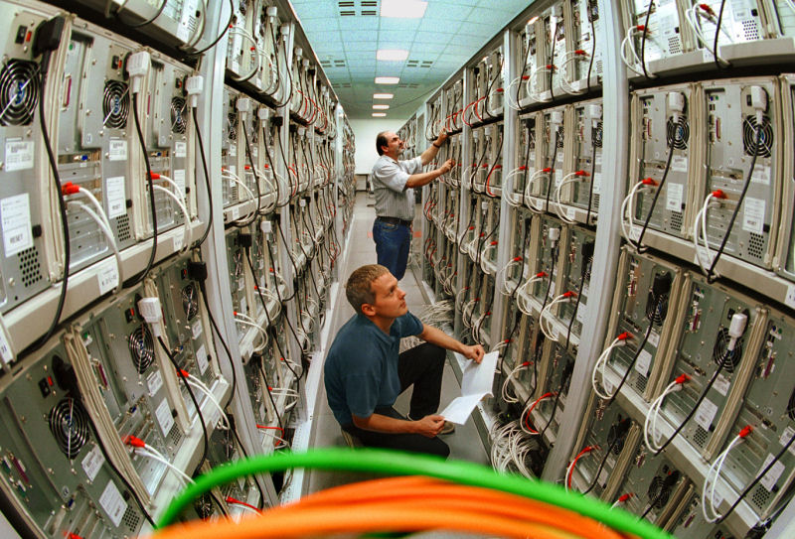
Problem: Outdated Training Data
RAG can compare to up-to-date sources
Image: https://commons.wikimedia.org/wiki/File:Kurzschluss_12V20A.jpg licensed CC-SA-3.0 by MdE
Huge cost for one training round for a large language model (LLM)
→ If info is out of date, welp, you can’t retrain it every day.
Image: https://commons.wikimedia.org/wiki/File:MEGWARE.CLIC.jpg licensed CC-SA-2.0 by MEGWARE Computer GmbH
Notes:
Sparks picture from https://commons.wikimedia.org/wiki/File:Kurzschluss_12V20A.jpg licensed CC-SA-3.0 by MdE.
Computer cluster pic from https://commons.wikimedia.org/wiki/File:MEGWARE.CLIC.jpg licensed CC-SA-2.0 by MEGWARE Computer GmbH.

Slide 8
Problem: Outdated Training Data
RAG updates info without changing software behavior
Application development requires some amount of stability.
→ Predictability may outweigh out of date info in a software process
Image: https://commons.wikimedia.org/wiki/File:Water_drop_001.jpg licensed CC-BY-2.0 by José Manuel Suárez
Notes:
Water drop pic is from https://commons.wikimedia.org/wiki/File:Water_drop_001.jpg licensed CC-BY-2.0 by José Manuel Suárez.

Slide 9
Problem: Most AI tools are generalist
RAG brings in domain specific info
Image: https://commons.wikimedia.org/wiki/File:Exponential_Collatz_Fractal.png licensed as CC0 by Hugo Spinelli
High training costs mean only a handful of very large tech companies are training models, and training infrequently.
→ Practically everything is built on an API for the same few tools
Notes:
This means that domain specific information is lacking. You can see a proliferation of tools branded as artificial intelligence. In reality, most tools that are actually using generative artificial intelligence are using APIs on the same handful of tools. The AI Now Institute is a good resource for market research on consolidation in the field. Also, you can see that if controlling this requires a specialized cluster of computers that can 7 figures, and requires lots of electricity, and requires someone with specialized training to configure and prepare training data: Then these are all things that lead to consolidation.
For someone researching in a specific field, if they are using a large language model, it’s probably a generalist model.
Fractal pic from https://commons.wikimedia.org/wiki/File:Exponential_Collatz_Fractal.png licensed as CC0 by Hugo Spinelli.

Slide 10
Corporate Benefits of RAG
Notes:
Today, dominant search engines, like Google and Bing, are putting AI summaries prominently into search results. Essentially, they are merging chatbots and search and doing it in the form of retrieval augmented generation.
Dominant search engines have strong business reasons for this, which are unrelated to the quality of search results or quality of generative artificial intelligence responses.
→ Corporate benefits, rather than research benefits.

Slide 11
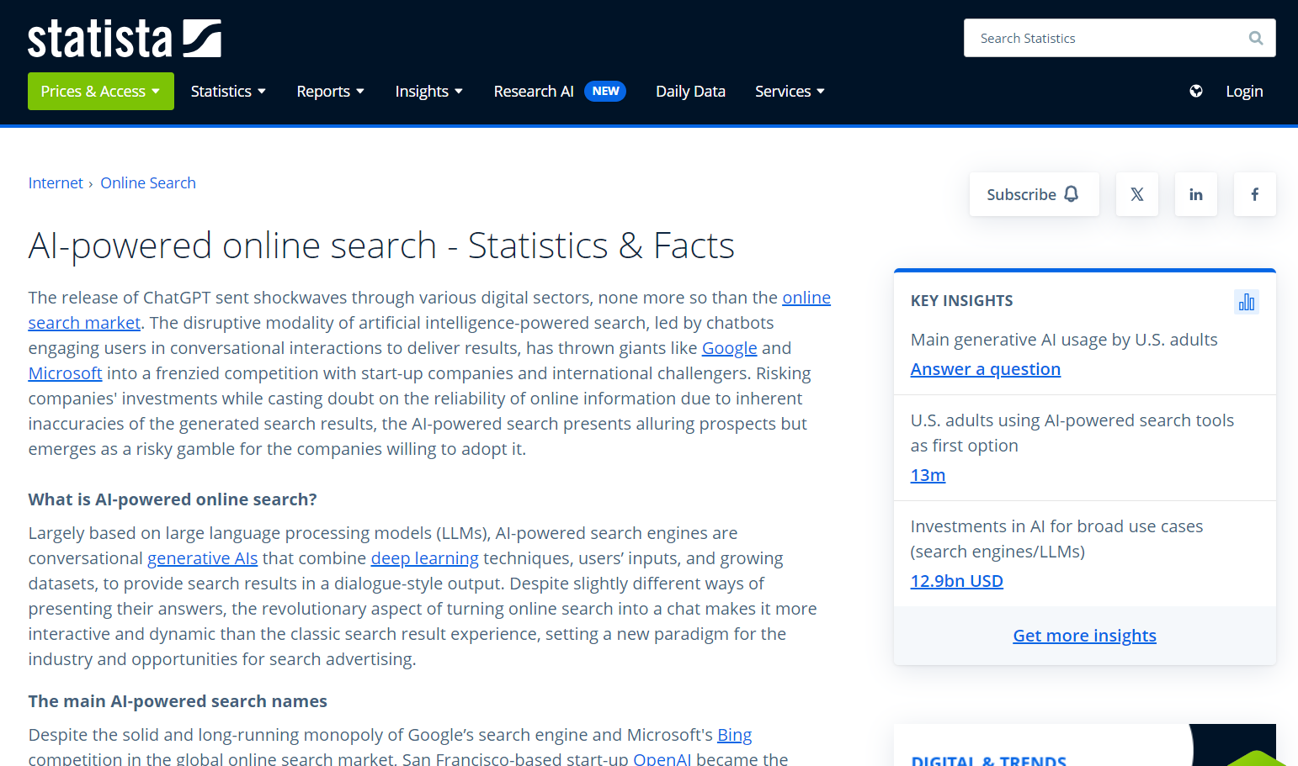
RAG can maintain the status quo for dominant search engines
Chatbots compete with search.
→ Converging chatbot and search engine may favor already-dominant tech companies.
Notes:
There is market research indicating that for some people, chatbot conversationalist style research has replaced search engine use. It may be the case that different people prefer different styles of search, with some people preferring a chatbot. Dominant search engines may want to capture that market share by playing to both styles.
Statista article about chatbots competing with search engines as the way that people find information: https://www.statista.com/topics/10825/ai-powered-online-search/#topicOverview

Slide 12
RAG limits copyright infringement liability
Notes:
Search engines have long been established to be fair use. Part of the reasoning is that with image thumbnails and search snippets, it’s just a little piece of the work that’s reproduced. And the link directs traffic to that site.
Having the link to the source makes the chatbot summary legally more like a search result. It gets the chatbot text into a safe space.
Kelly v. Arriba-Soft
Perfect 10 v. Google

Slide 13
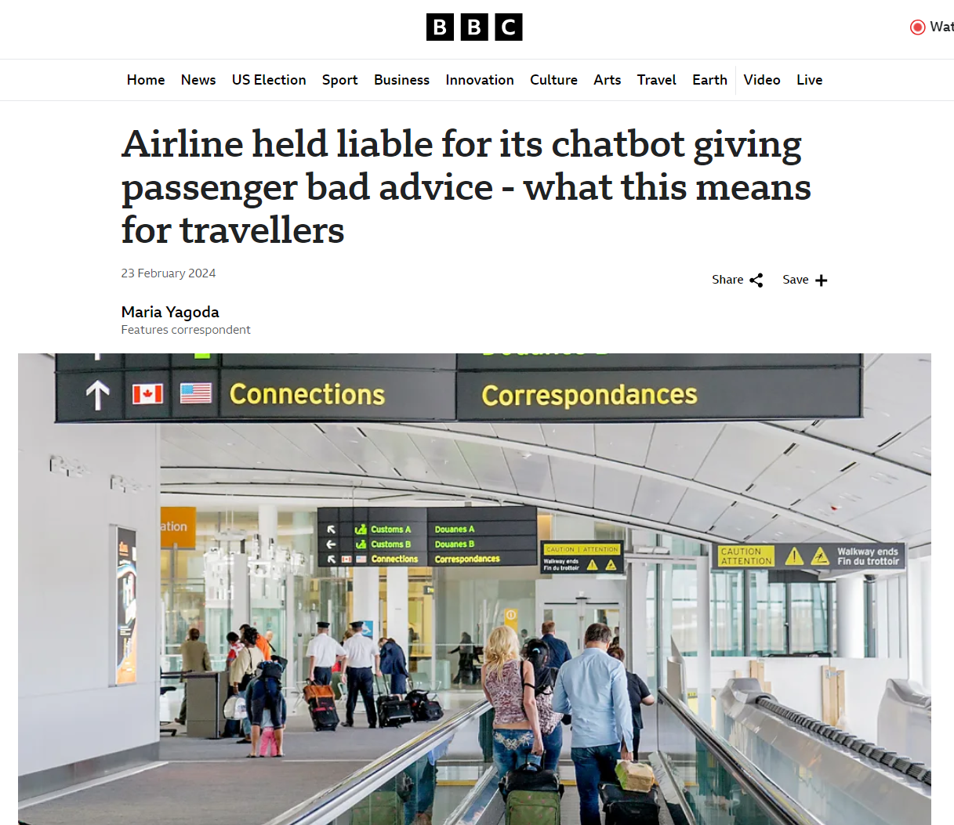
RAG limits misinformation liability
Section 230 protects a web platform hosting content made by someone else.
Chatbot text is not made by someone else, so no section 230 immunity. But… search results are someone else’s content.
Notes:
Article about first amendment immunity for search engine results: https://calawyers.org/publications/antitrust-unfair-competition-law/competition-spring-2014-vol-23-no-1-first-amendment-protection-for-search-engine-search-results/

Slide 14
From RAG to Riches?
Corporate Control in the AI Research Era
Wilhelmina Randtke, Nikki Canon-Rech, Kevin Reagan
Charleston Conference, Charleston, South Carolina, November 15, 2024
Notes:
So, when you hear about retrieval augmented generation, that’s some of the background. It has research benefits in that it’s mitigating some of the problems inherent to generative artificial intelligence.
Meanwhile, corporate control by large tech companies is intertwined with retrieval augmented generation. Many of those problems - basically everything other than misinformation - are tied to how resource intensive training is. That same resource intensive training tends to lead to consolidated control of generative artificial intelligence in just a few companies. And, when you see large tech companies building retrieval augmented generation into their search engines, they have market share interests and liability interests in presenting chatbots in the context of retrieval augmented generation.

