Slide 1
Unlikely Collaborators, Uncharted Waters: Toward an AI-Grounded Pedagogy for Information Literacy and the ACRL Framework
Kevin Reagan and Wilhelmina Randtke
Georgia Association for Instructional Technology IT Forum 2024
March 16, 2024

Slide 2
Abstract
Librarians are positioned to lead in teaching how to use AI. We show examples of exercises which teach how to use AI as part of the research process, with a focus on classroom exercises compatible with library instruction sessions, and we are organizing our classroom exercises around the ACRL Framework.

Slide 3
Introducing the ACRL Framework for Information Literacy in Higher Education
Predecesor: Information Literacy Competency Standards for Higher Education (2000)
Adopted in 2016
Set up dispositions for students: information literacy as a process
DJ Palyeado, CC BY-SA 4.0 <https://creativecommons.org/licenses/by-sa/4.0>, via Wikimedia Commons
Notes:
Kevin

Slide 4
Misinformation, content farms, and artificial intelligence
The ACRL Framework was designed to address voluminous information and misinformation: “[T]he rapidly changing higher education environment, along with the dynamic and often uncertain information ecosystem in which all of us work and live, require new attention to be focused on foundational ideas about that ecosystem.” (ACRL, 2016, 7).
mikemacmarketing, CC BY 2.0 <https://creativecommons.org/licenses/by/2.0>, via Wikimedia Commons
Notes:
(Mina)
I put there a quote from the introduction section of the ACRL Framework. The Framework is a response to more voluminous, and less reliable online information. That was in the context of human written information with lots of pressure from algorithms. It’s been decades now that content online is written for search engine optimization and engagement rather than truth, and essentially written for algorithms.
With generative artificial intelligence, that’s a natural extension of past online information trends. For a website with unvetted content written for search engines, in the past that’s been done by content farms with paid bloggers abroad or underemployed people in the US doing low paid writing gigs. In the future, that will include chatbot generated content on blogs, on websites, and coming out of the chatbot. The source of the content doesn’t matter super much. In the past, we had people writing for algorithms and engagement rather than truth, and going forward we will have people and artificial intelligence writing for algorithms and engagement rather than truth. The ACRL Framework was designed to teach research in this current information ecosystem. The ACRL Framework has been around since 2016, there are lots of polished lesson plans out there, and they either already cover or can be easily adapted to artificial intelligence.

Slide 5
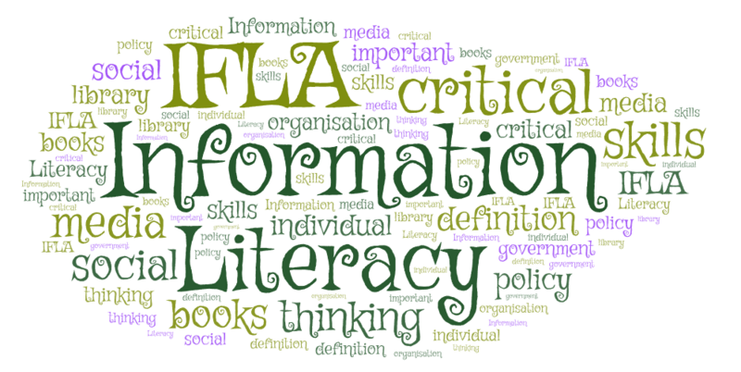
The ACRL Framework
The Frames:
Authority Is Constructed and Contextual
Information Creation as a Process
Information Has Value
Research as Inquiry
Scholarship as Conversation
Searching as Strategic Exploration
WordArt.com, CC0, via Wikimedia Commons
Notes:
Kevin

Slide 6
Strategies for teaching artificial intelligence in the classroom
Acceptance: AI is here to stay
Identify why and how students are likely to use AI in your classroom
Deploy active learning activities to encourage the ethical use of AI
Use HuggingChat: Does not require login
Mam'Gobozi Design Factory (MDF), CC BY-SA 4.0 <https://creativecommons.org/licenses/by-sa/4.0>, via Wikimedia Commons
Notes:
(Kevin)

Slide 7
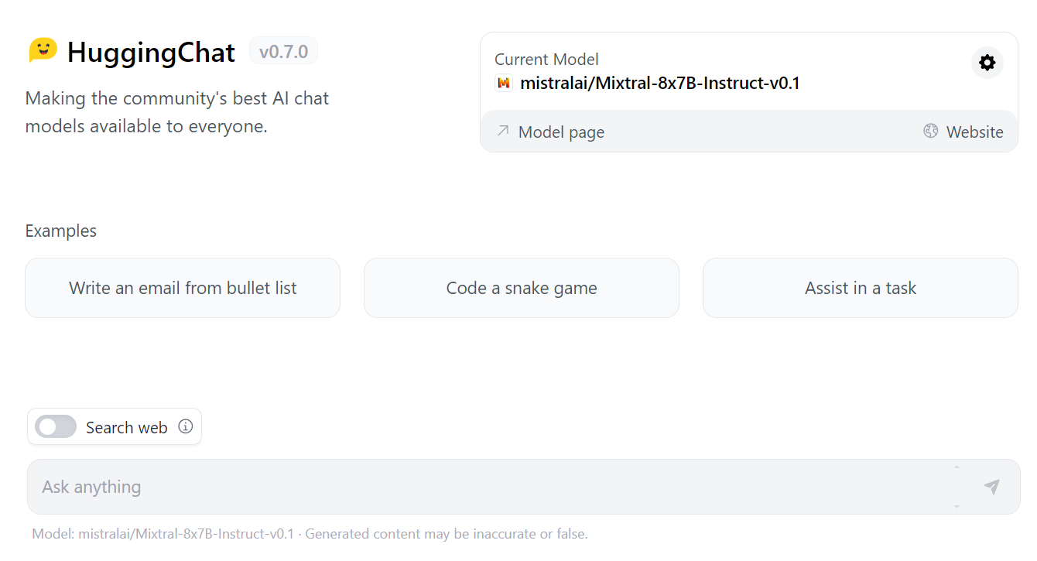
Hugging Chat
Notes:
Kevin R.

Slide 8
Authority is Constructed & Contextual & Information Creation as a Process
ROBOT Test: Reliability, objectivity, bias, ownership, & type (Wheatley & Hervieux, 2023).
Hidden Layer: Intellectual Privacy and Generative AI (Hartman-Caverly, 2023).
Card games to teach how machine learning algorithms work (Bell & Talboom, 2023)
Rigo Peter, CC BY 4.0 <https://creativecommons.org/licenses/by/4.0>, via Wikimedia Commons
Notes:
(Kevin)

Slide 9
Searching as Strategic Exploration &
Research as Inquiry
Search tools comparison (Fitzgibbons, 2023).
Teaching prompt engineering with an analogy to shooting pool (Nesbitt & Stilwell, 2023).
The Case of the Unsolved Hallucination (Reagan, 2024a).
Artificial intelligence generated images of hands made by Dall-E 2 and featuring hallucinated extra fingers.
Notes:
(Mina)
We have citations on these. And there is a “References” slide at the end of the presentation! Here are 3 sample lessons you can pull up and use to teach artificial intelligence. These lesson plans were designed to teach either the frame “research as strategic exploration” or “research as inquiry”.
First, we have search tools comparison. Who here has taught a lesson where you have students use two different search engines to research the same topic? It’s pretty common - compare two search engines; compare a search engine and a database like academic search complete. With chatbots, that same lesson plan can be adapted to also ask a chatbot. Or, where a chatbot has been added to a search engine, such as Bing CoPilot, students can compare searching with and without the chatbot.
Next lesson is a lesson plan about teaching database and search engine techniques, adapted to prompt engineering. The lesson plan is to use an analogy to shooting pool. With a database or search engine, you would run the search, then your search results come in and you skim them and then tweak the search to get better results. Searching a strategic exploration. Similarly, with a chatbot and with prompt engineering, it is not just once and you are done. Instead, you would prompt, then review the results, then change your prompt to get better results closer to what you need.
Third lesson explores the tendency of generative artificial intelligence to hallucinate, or make things up. Students a given citations to 2 sources. One is a hallucinated source made up by artificial intelligence. The other is a real citation. Students have to research to find out which source really exists. Students break into groups, determine which is real, then share their findings. This can start a discussion about retrieving papers and source material from authoritative sources.

Slide 10
Scholarship as Conversation &
Information Has Value
AI Prompt Engineering (Reagan, 2024d)
Building Confidence in using AI to Generate Citations (Reagan, 2024b)
AI & Personal Information: An Investigation(Reagan, 2024c)
Riemogerz, Public domain, via Wikimedia Commons
Notes:
(Kevin) Go more in depth

Slide 11
Disclaimer: Digital Divide & AI Divide
Alan Turin9, CC BY-SA 4.0 <https://creativecommons.org/licenses/by-sa/4.0>, via Wikimedia Commons
Notes:
Kevin R: Skip if needed

Slide 12
References
Association of College and Research Libraries (ACRL) (2016). ACRL Framework for information literacy for higher education. Chicago, IL: American Library Association. https://www.ala.org/acrl/sites/ala.org.acrl/files/content/issues/infolit/framework1.pdf
Bell, M. and Talboom, L. (2023). More Than Just Algorithms: A Machine Learning Club for Information Specialists. In The Rise of AI: Implications and Applications of Artificial Intelligence in Academic Libraries (pp. 61-70). Association of College and Research Libraries.
Fitzgibbons, M. (2023). Concordia University Library, April 2023. Search tools comparison (jigsaw group activity). ACRL Sandbox. https://sandbox.acrl.org/library-collection/search-tool-comparison-activity
Fonseca, T., & King, M. (2000). Incorporating the Internet into Traditional Library Instruction. Computers in Libraries, 20(2), 38.
Hartman-Caverly, S. (2023). Hidden layer: Intellectual privacy and generative AI. ACRL Sandbox. https://sandbox.acrl.org/system/tdf/resources/HiddenLayer_LessonPlan_CCBYSA_HartmanCaverly_2023.pdf
Hugging Face. (n.d.). HuggingChat. Retrieved March 15, 2024 from. https://huggingface.co/chat/
Nesbitt, T. and Stilwell, K. (2023, October 4-6). AI and the Meta Poster [Conference presentation]. Georgia Library Conference, Athens, GA, United States. https://www.canva.com/design/DAFtJUH6kXU/IBErazVEjP_thvjN5ZoQOw/view
Reagan, K. (2024a). The Unsolved Case of the Hallucination. https://sandbox.acrl.org https://georgiasouthern.libguides.com/informationliteracyai
Reagan, K. (2024b). Building citations with AI. https://georgiasouthern.libguides.com/informationliteracyai
Reagan, K. (2024c). AI & Personal Information Commodification. https://georgiasouthern.libguides.com/informationliteracyai
Reagan, K. (2024d). Engineering AI prompts to develop keywords. https://georgiasouthern.libguides.com/informationliteracyai
Wheatley, A. and Hervieux, S. (2023). Separating Artificial Intelligence from Science Fiction: Creating an Academic Library Workshop Series on AI Literacy. In The Rise of AI: Implications and Applications of Artificial Intelligence in Academic Libraries (pp. 61-70). Association of College and Research Libraries.
Notes:
(no one presenting; informational only)

Slide 13
Continuing the Conversation
We are interested in collecting more lesson plans using the ACRL Framework, which are easily adaptable to teaching artificial intelligence. If you have any to share, feel free to email us at kreagan@georgiasouthern.edu or wrandtke@georgiasouthern.edu to share.
Notes:
(no one presenting; informational only)

Slide 14
Unlikely Collaborators, Uncharted Waters: Toward an AI-Grounded Pedagogy for Information Literacy and the ACRL Framework
Kevin Reagan and Wilhelmina Randtke
Georgia Association for Instructional Technology IT Forum 2024
March 16, 2024

